Slide 1




Oracle Digital Accounting Specialist ERP System General Ledger

Slide 2
Group Members
Islam Mohammed Wheed Ibrahim
Mahmoud Mohamed Mahmoud Lotfy
Ahmed Sayed Abdelhalim Mohamed
Shehab Ahmed Eid Ahmed
Mahmoud Muhamed Abdeljalil ibrahim
Abdallah Khaled Rabie
Mohamed Nassary Abou Elhamd Gaber
Abdelrahman Magdy Hamed Hassane
Supervisor: Eng, Ahmed Hosni

Slide 3


Introduction To Oracle General Ledger
Oracle General Ledger module within Oracle Financials is an integrated part of the ERP package Oracle applications. It is a financial management solution within E-business suite for entering Journals, planning and budgeting, financial reporting etc of large companies. Oracle claims that it's GL module can import and post 42 million journal lines per hour, which would make it a suitable GL application for very large enterprises whose volume of GL transactions are very high..

Slide 4
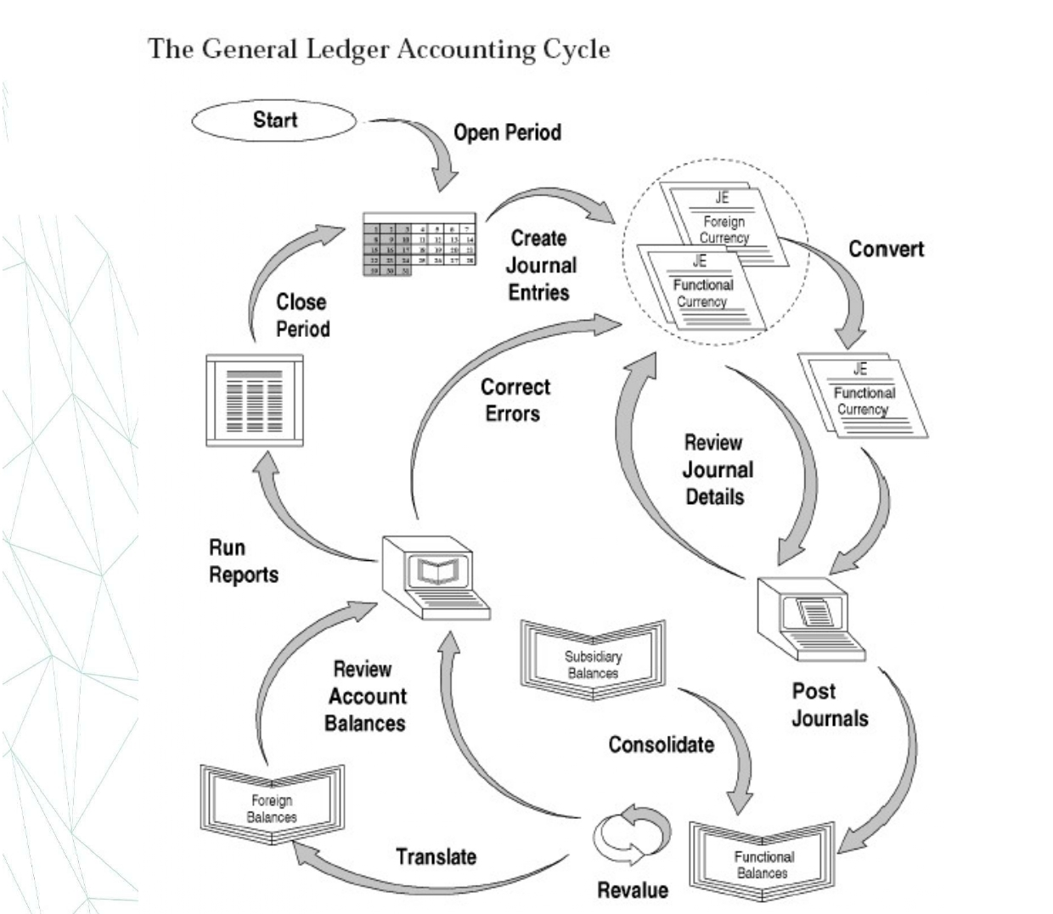

Slide 5
Define Accounting Setups Using Accounting Setup Manager The Accounting Setup Manager streamlines the implementation of your Oracle Financial Applications by centralizing the setup steps for the following common setup components that are shared across Oracle Financial Applications:
Legal entities.
Ledgers (primary and secondary ledgers).
Reporting currencies.
Oracle Subledger Accounting (SLA).
Intercompany accounts.
Intracompany balancing rules.
Sequencing options.

Slide 6
The accounting setup process consists of the following steps:
Create an Accounting Setup Structure: The accounting setup structure creates the framework of the accounting setup and identifies the legal entities, if any, type of accounting setup, and ledgers.
Complete Accounting Options: Depending on the type of accounting setup you define, you must complete different accounting options to specify how you want to perform accounting and process transactions. Accounting options include ledger options, reporting currency options, subledger accounting options, intercompany accounts, intracompany balancing rules, and sequencing options.
Complete the Accounting Setup: Completing the accounting setup marks the accounting setup complete and launches the General Ledger Accounting Setup program. This program performs the necessary validations to make the setup components of an accounting setup ready for transaction processing and journal entry.

Slide 7
Define Legal Entities: -
If you plan to record accounting transactions for one or more legal entities, you can use Oracle Legal Entity Configurator or the Legal Entities tab in Accounting Setup Manager to define your legal entities. Note: The Legal Entity pages of Accounting Setup Manager are the same as the Legal Entity pages in Legal Entity Configurator. The only difference is that you can assign balancing segment values to legal entities using Accounting Setup Manager. It is strongly recommended that you assign specific and unique balancing segment values to your legal entities to help you identify legal entities during transaction processing and reporting and take full advantage of all of the legal entity-related features. Note: If you plan to use jurisdictions that do not come seeded, you can define your own jurisdictions using Legal Entity Configurator before you define legal entities. A jurisdiction is the intersection of the physical territory and type of legislation within which judicial authority may be exercised. The jurisdiction is used to assign a territory to a legal entity. Note: In General Ledger, a legal entity set up in the Accounting Setup Manager cannot be associated to an Human Resources (HR) organization. General Ledger views each as separate entities. The HR model does not use this model. To satisfy the HR requirement you can select GRE/LE as the HR organization type.

Slide 8
Define Subledger Accounting Methods
If you plan to use Oracle Subledger Accounting (SLA) to integrate data from Oracle Financial Subledgers and non-Oracle systems with Oracle General Ledger, you can define subledger accounting methods using Oracle Subledger Accounting (SLA).
Oracle Subledger Accounting seeds two subledger accounting methods: Standard Accrual and Standard Cash. If you want to define your own subledger accounting methods, you must define them using Oracle Subledger Accounting.
When you define ledgers in Accounting Setup Manager, you can optionally assign a subledger accounting method to your ledger to use this feature.
You must perform this step for each subledger accounting method.

Slide 9
Setting Up General Ledger: -
Oracle General Ledger
Oracle Payables
Oracle Receivables
Oracle Cash Management
Oracle Assets
Oracle Purchasing

Slide 10
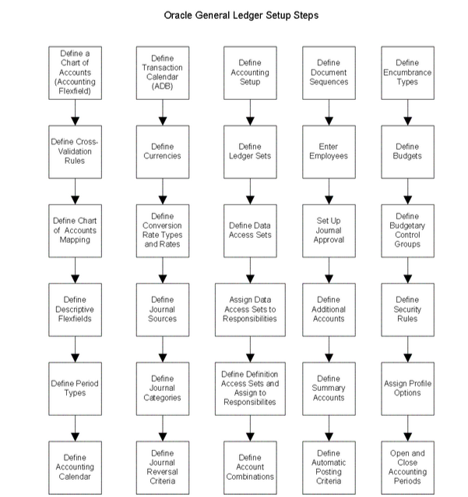
General Ledger Setup Flowchart

Slide 11
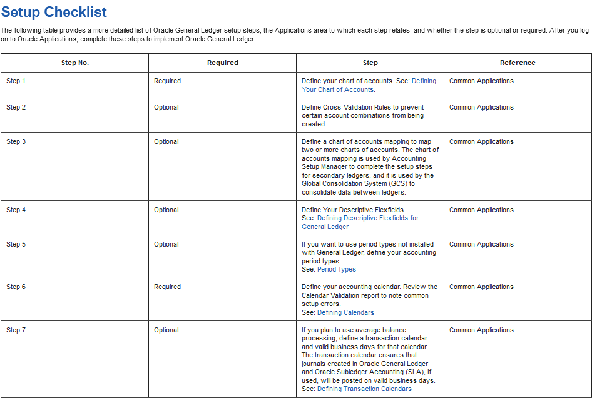
Accounting Setup Manager

Slide 12
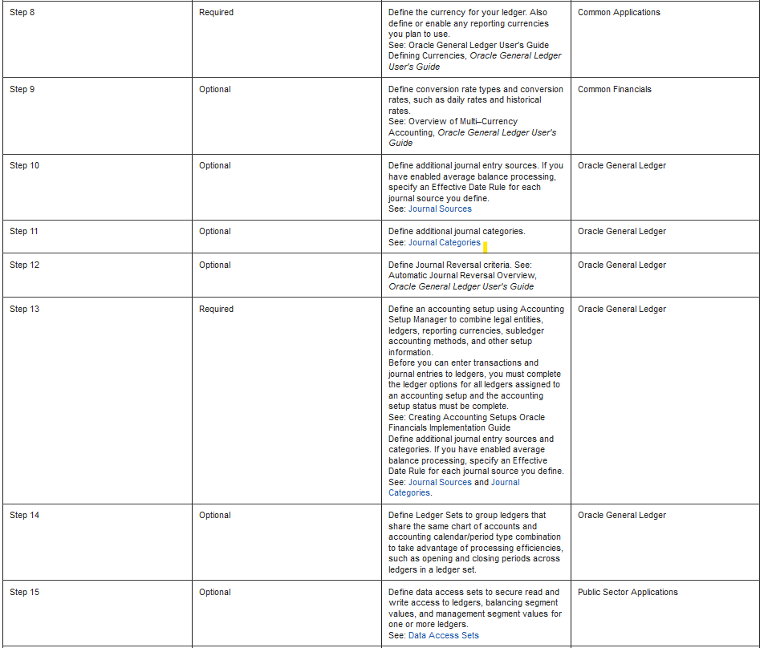
Accounting Setup Manager

Slide 13
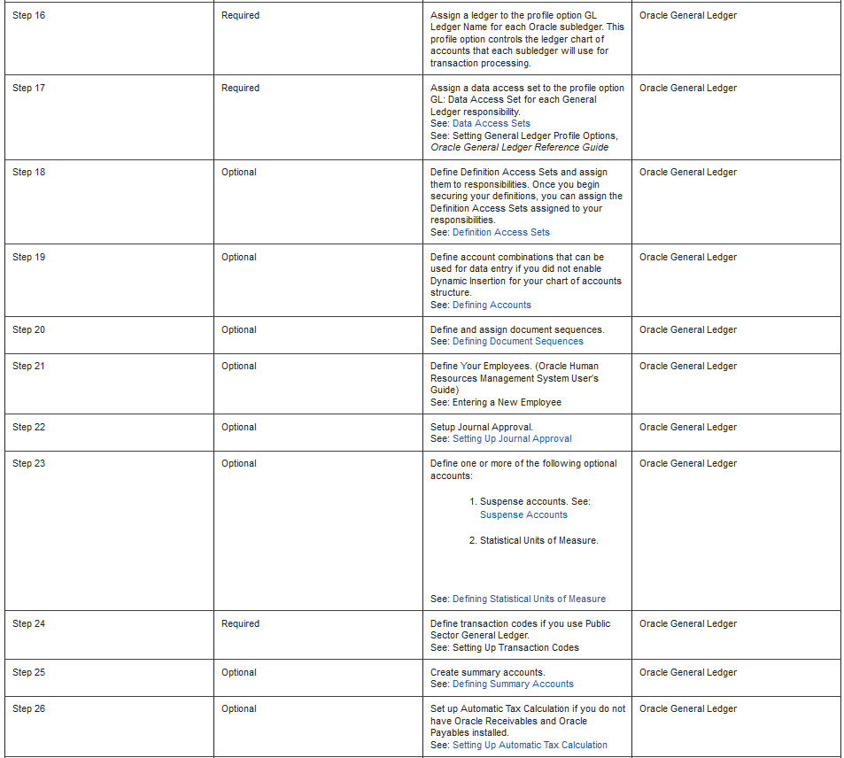
Accounting Setup Manager

Slide 14
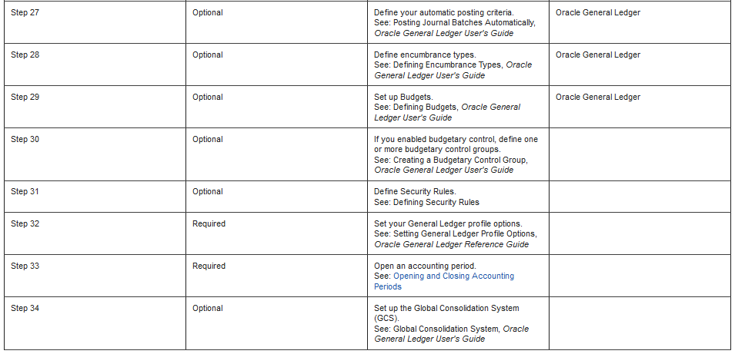
Accounting Setup Manager

Slide 15
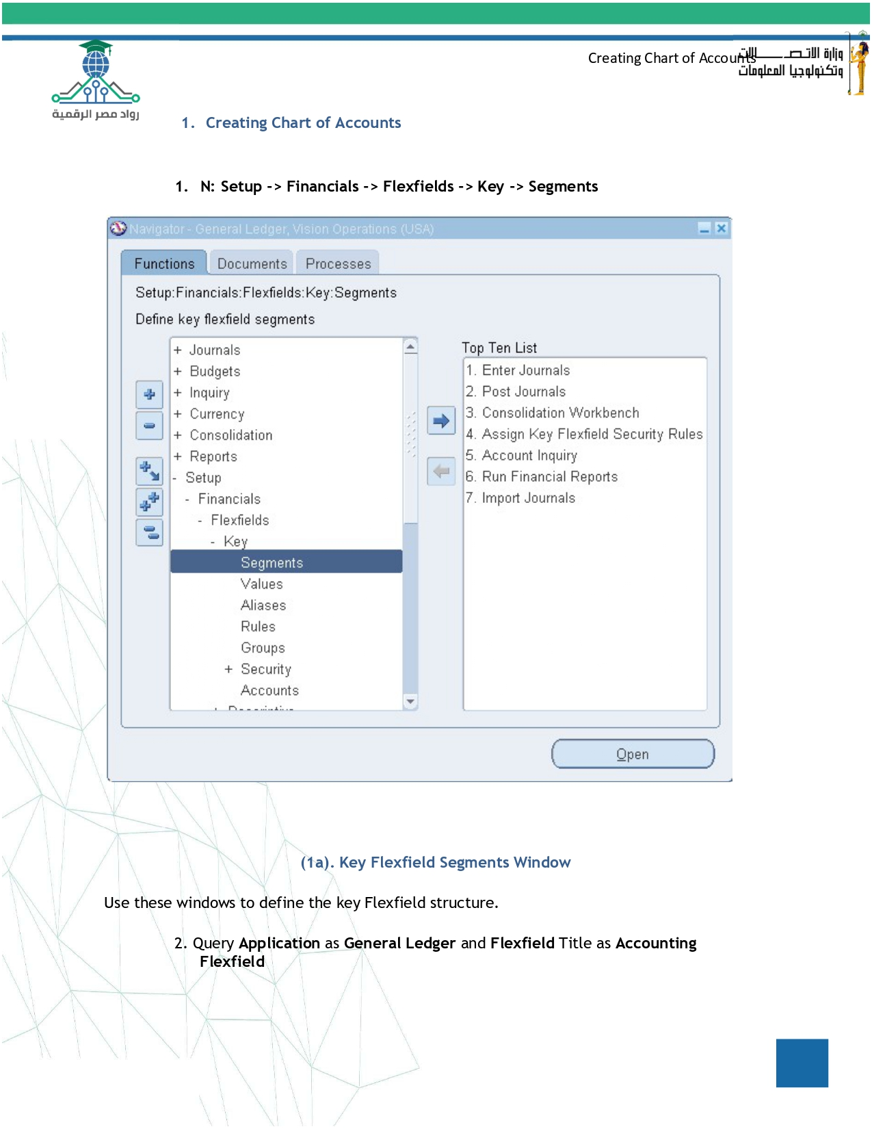

Waiting Line System
Waiting line analysis involves studying the behavior of queues or waiting lines to improve service efficiency and customer satisfaction.
Key components of Waiting line:
Arrival process: Describes how customers arrive at the service facility
Service process: Describes how customers are served
Service channels: The number of servers available to provide service
Types of Waiting line models:
Single server model
Multiple server model

Slide 16
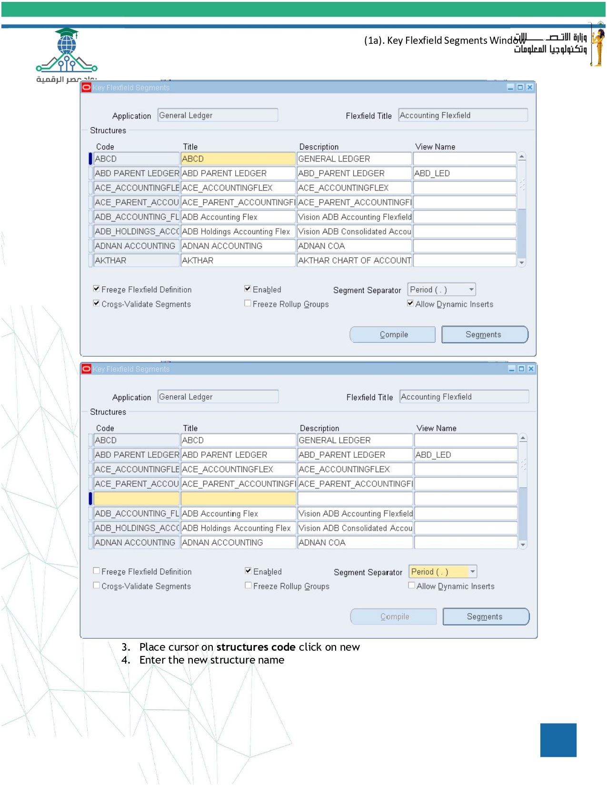
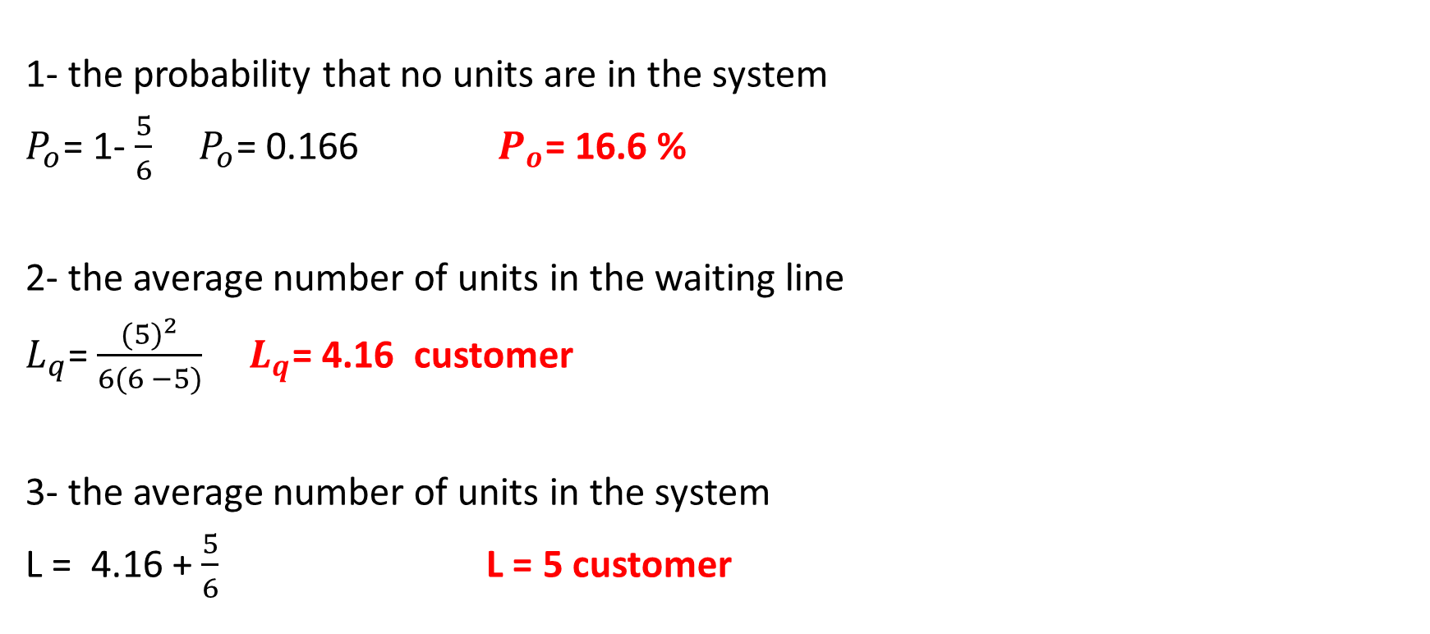
Operating Characteristics ( performance measures ) One single server k = 1
1- the probability that no units are in the system
$P_{o}$= 1- $\frac{5}{6}$ $P_{o}$= 0.166 $P_{o}$= 16.6 %
2- the average number of units in the waiting line
$L_{q}$= $\frac{{(5)}^{2}}{6(6 −5)}$ $L_{q}$= 4.16 customer
3- the average number of units in the system
L = 4.16 + $\frac{5}{6}$ L = 5 customer

Slide 17
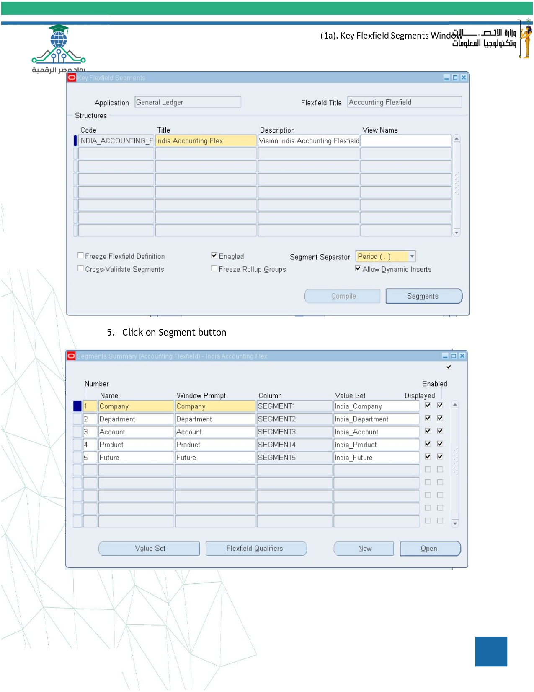
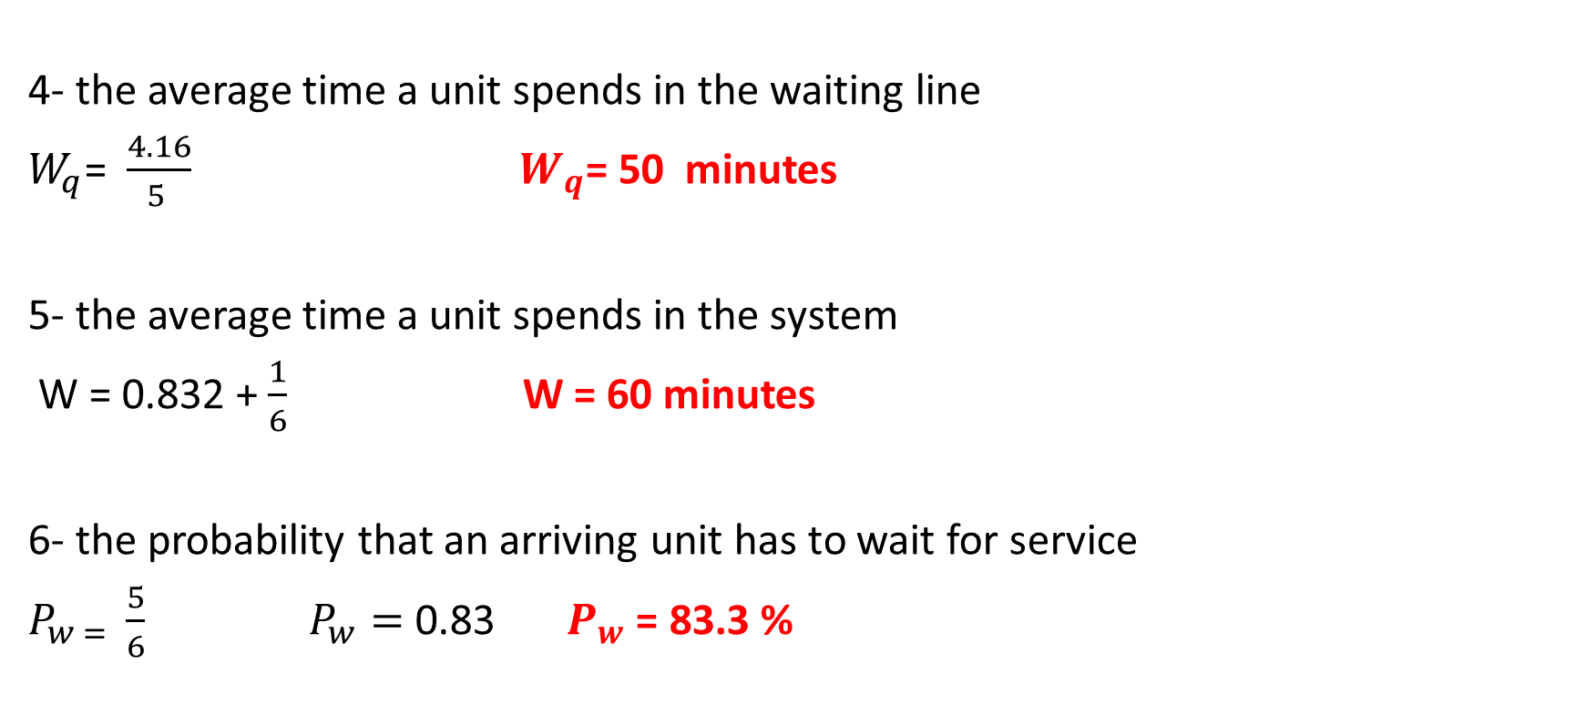
One single server k = 1
4- the average time a unit spends in the waiting line
$W_{q}$= $\frac{4.16}{5 }$ $W_{q}$= 50 minutes
5- the average time a unit spends in the system
W = 0.832 + $\frac{1}{6}$ W = 60 minutes
6- the probability that an arriving unit has to wait for service
$P_{w = }$ $\frac{5}{6}$ $P_{w}=$ 0.83 $P_{w}$ = 83.3 %

Slide 18
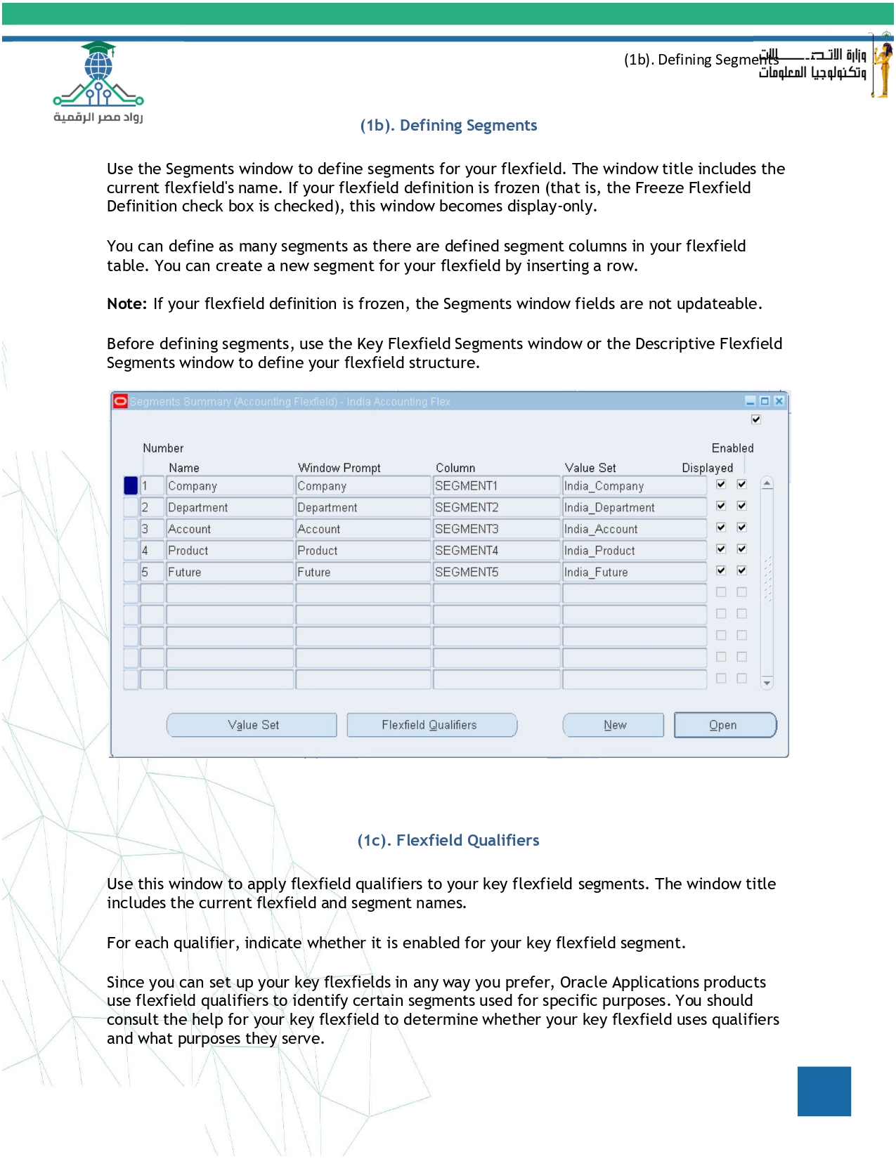
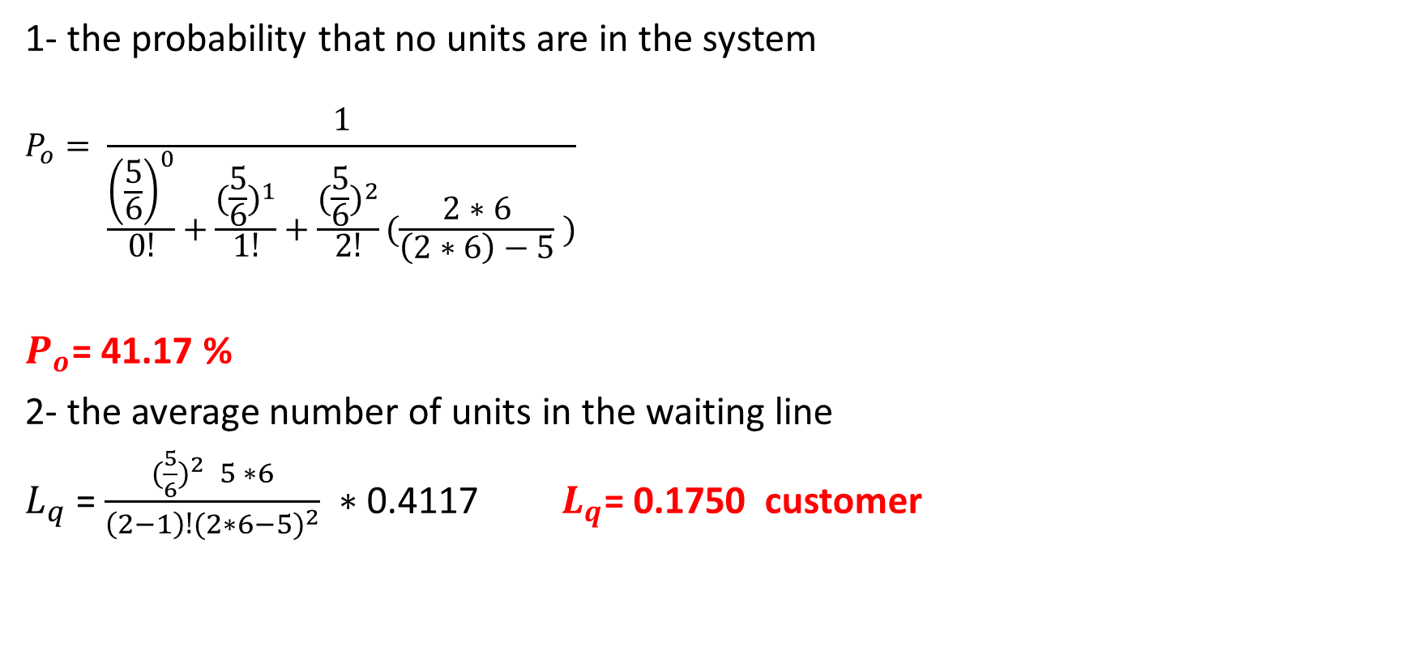
Multiple Server K = 2
1- the probability that no units are in the system
$$P_{o}= \frac{1}{\frac{{\left(\frac{5}{6}\right)}^{0}}{0ǃ}+\frac{{(\frac{5}{6})}^{1}}{1ǃ}+\frac{{(\frac{5}{6})}^{2}}{2ǃ}(\frac{2∗6}{\left(2∗6\right)−5} )}$$
$P_{o}$= 41.17 %
2- the average number of units in the waiting line
$L_{q}$ = $\frac{{(\frac{5}{6})}^{2} 5 ∗6}{\left(2−1\right)ǃ{(2∗6−5)}^{2}} ∗$0.4117 $L_{q}$= 0.1750 customer

Slide 19
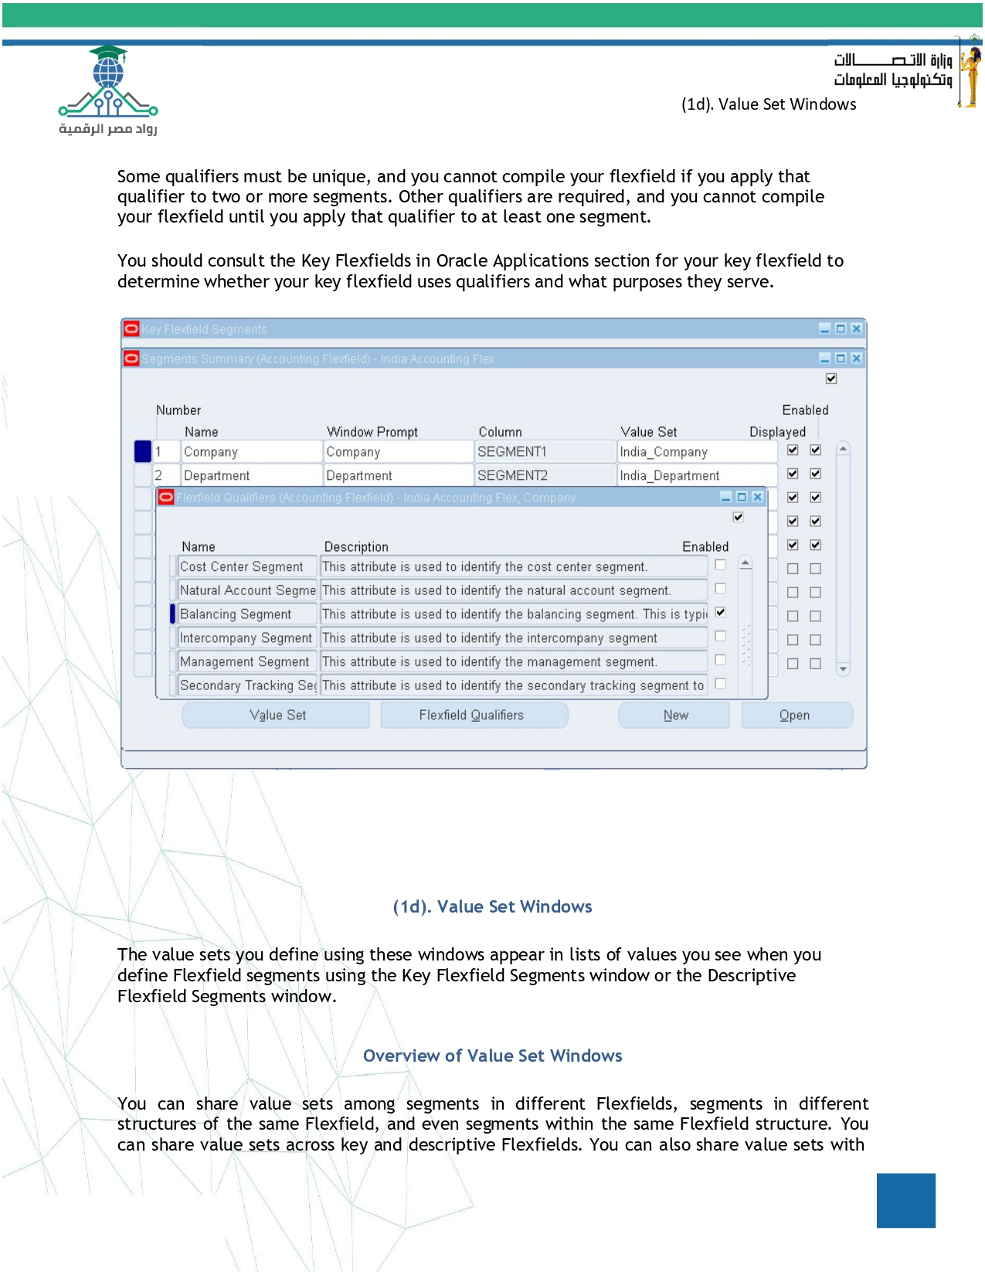
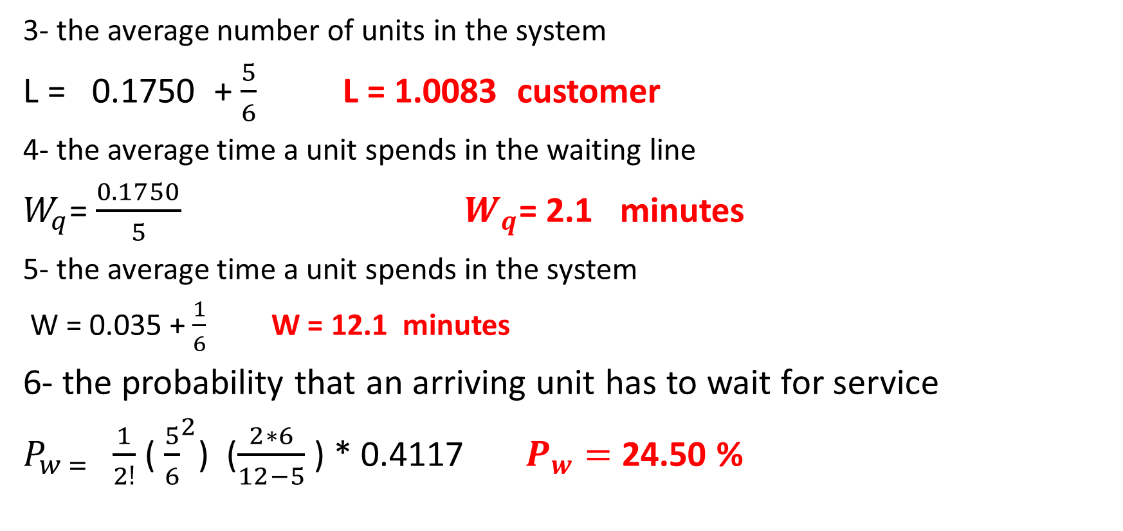
Multiple Server K = 2
3- the average number of units in the system
L = 0.1750 + $\frac{5}{6}$ L = 1.0083 customer
4- the average time a unit spends in the waiting line
$W_{q}$= $\frac{0.1750}{5}$ $W_{q}$= 2.1 minutes
5- the average time a unit spends in the system
W = 0.035 + $\frac{1}{6}$ W = 12.1 minutes
6- the probability that an arriving unit has to wait for service
$P_{w = }$ $\frac{1}{2ǃ}$ (${\frac{5}{6}}^{2}$) ($\frac{2∗6}{12−5}$ ) * 0.4117 $P_{w}=$ 24.50 %

Slide 20
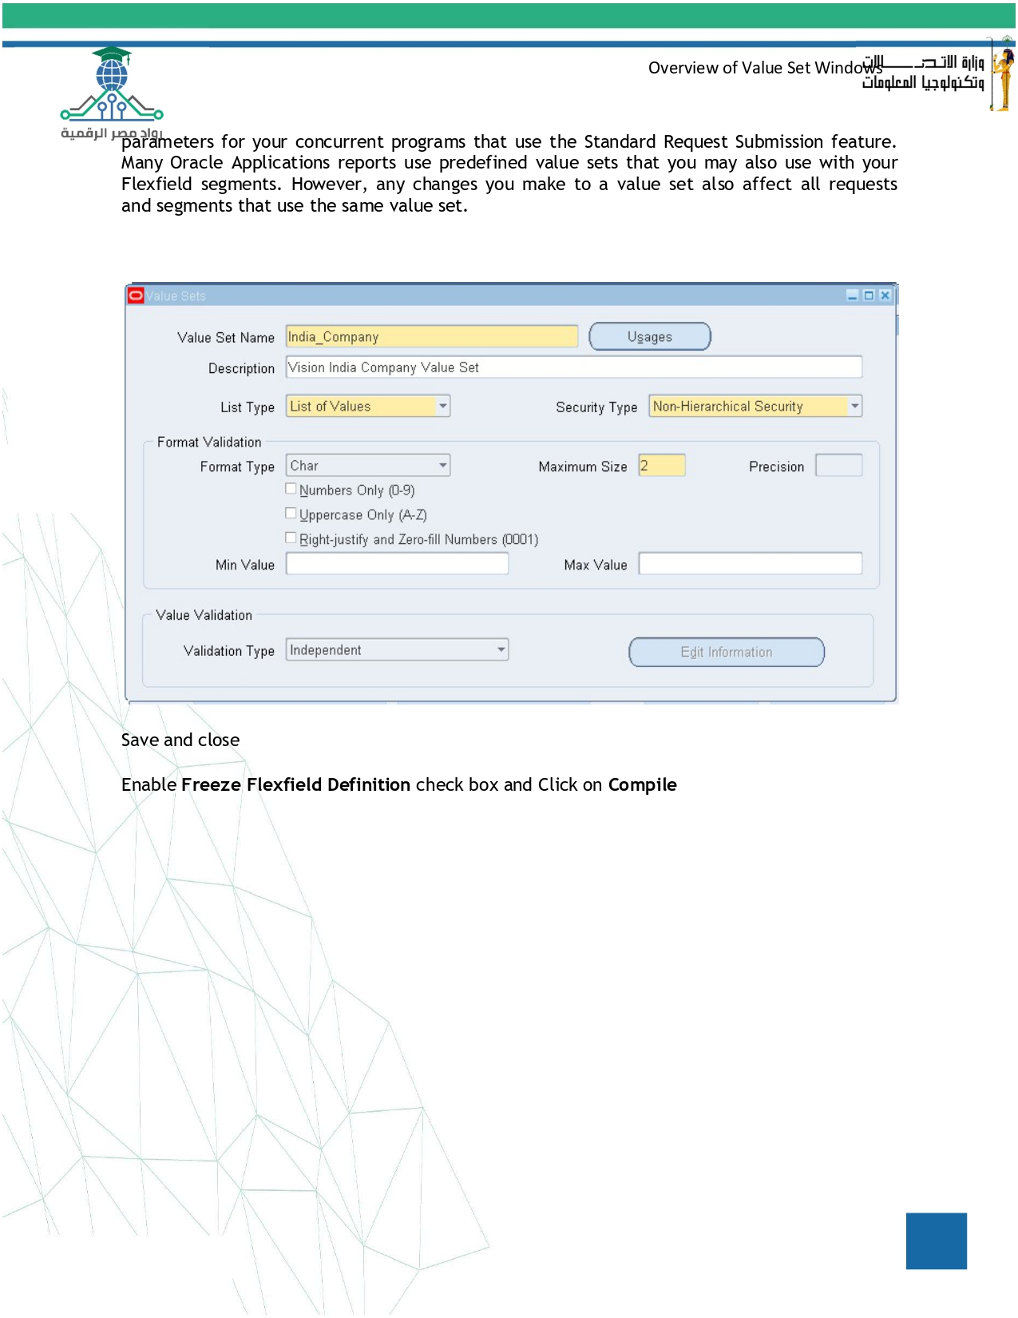
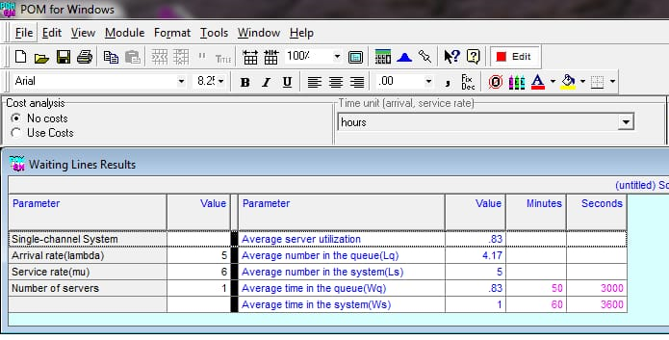
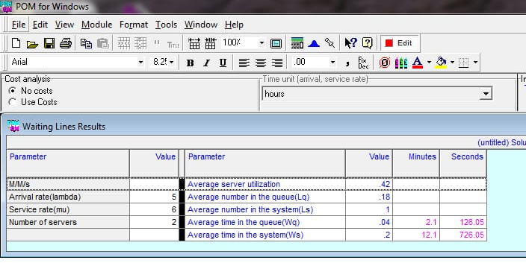
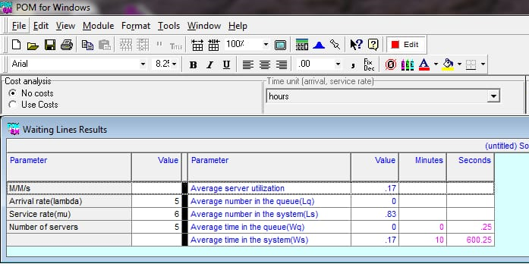
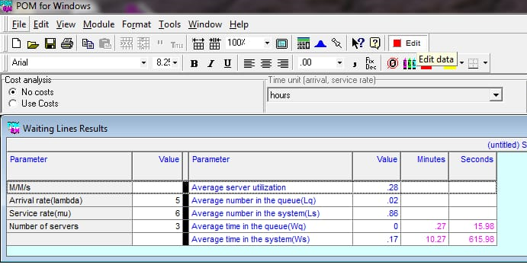
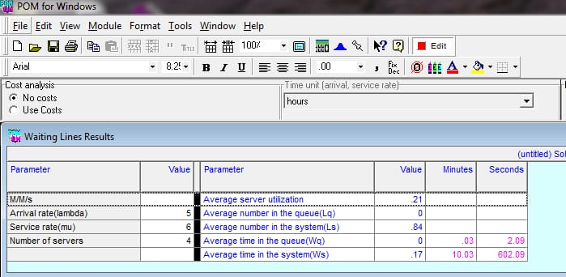

Slide 21
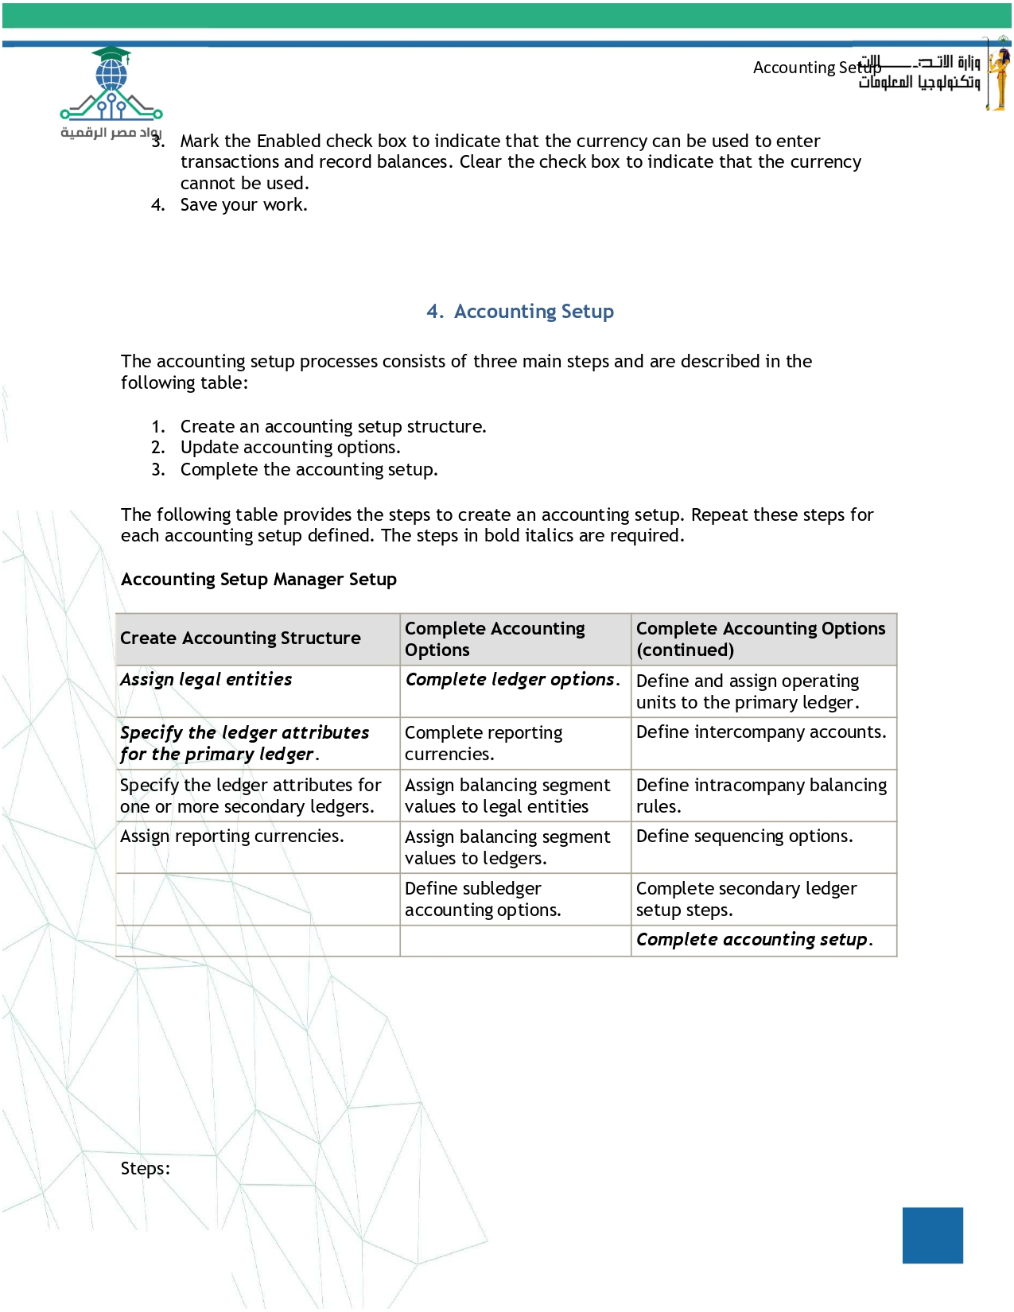
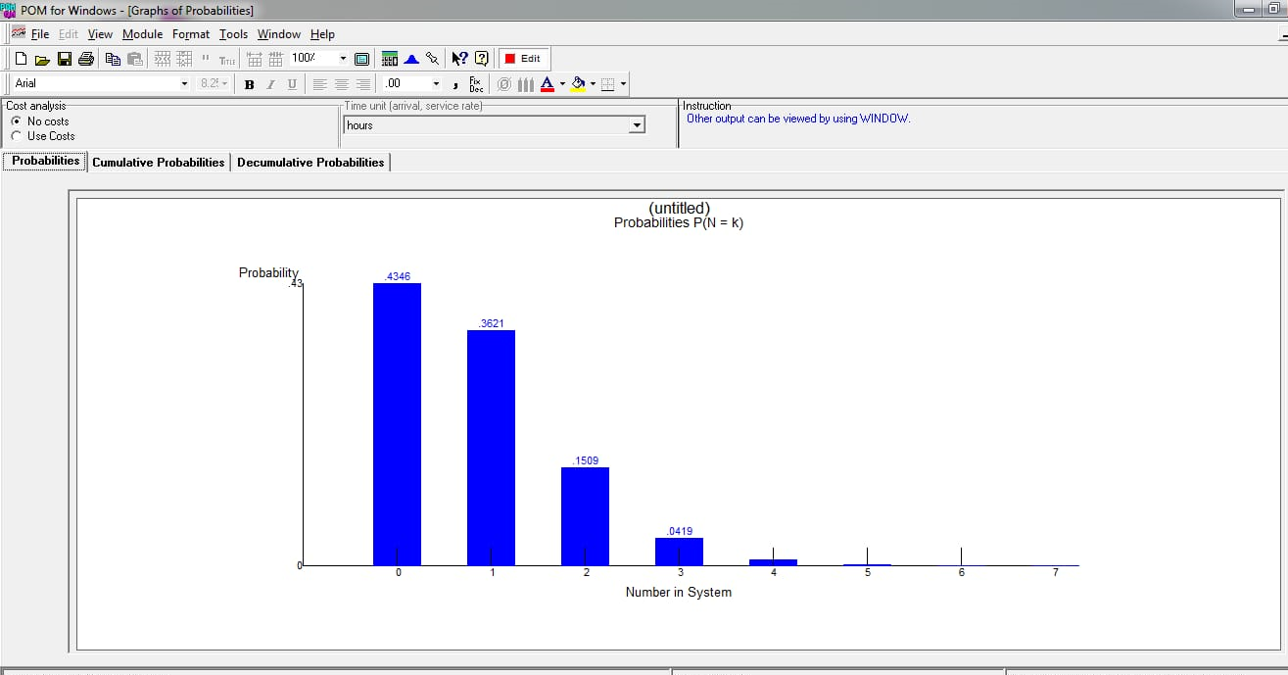
 | Average server utilization | average number in queue | average number in the system | Average time in queue | average time in the system
K1 | 0.83 | 4.17 | 5 | 50 min | 60 min
K2 | 0.42 | 0.18 | 1 | 2.1 min | 12 min
K3 | 0.28 | 0.02 | 0.86 | 17 sec | 10.3 min
K4 | 0.21 | 0 | 0.84 | 3 sec | 10.1 min
K5 | 0.17 | 0 | 0.83 | 1 sec | 10 min

Slide 22
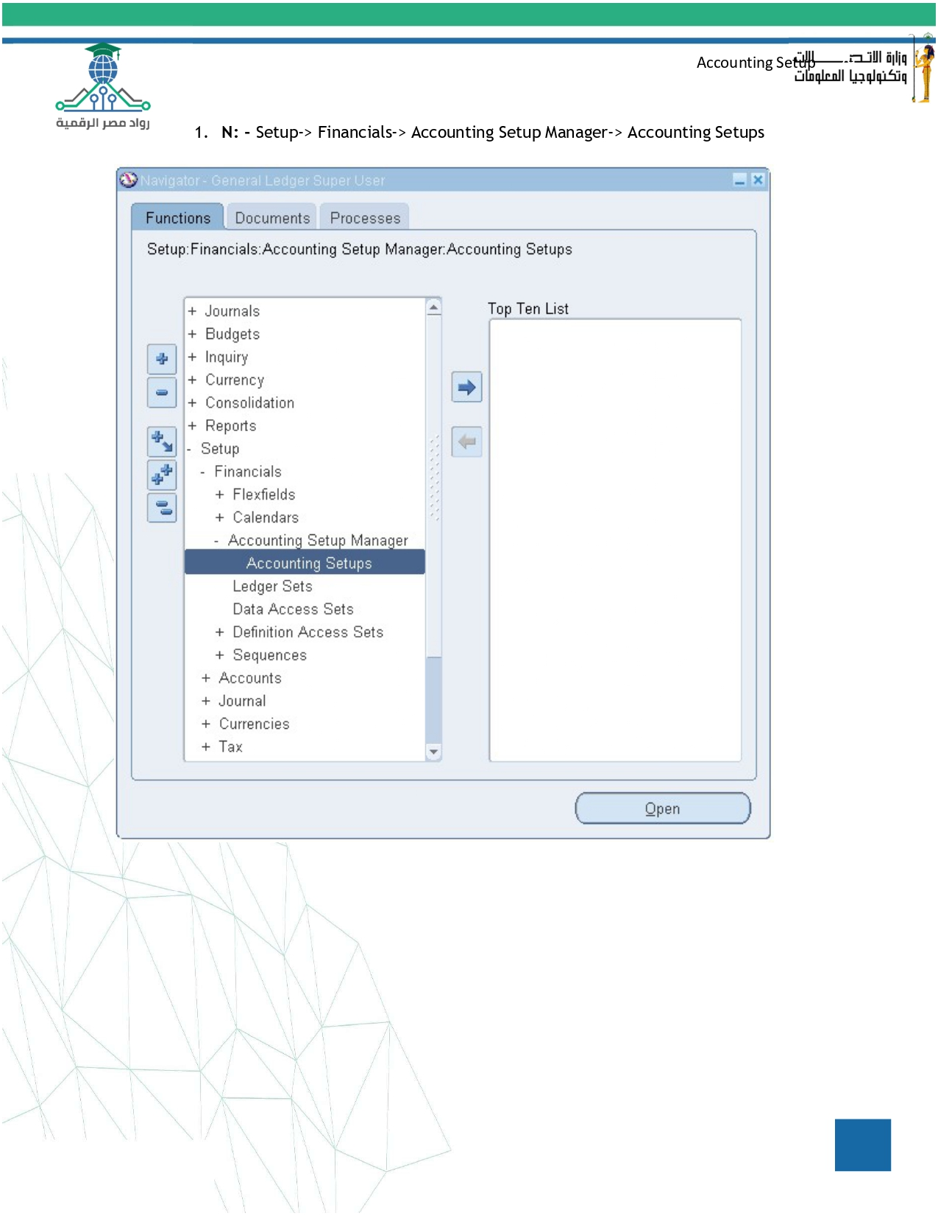
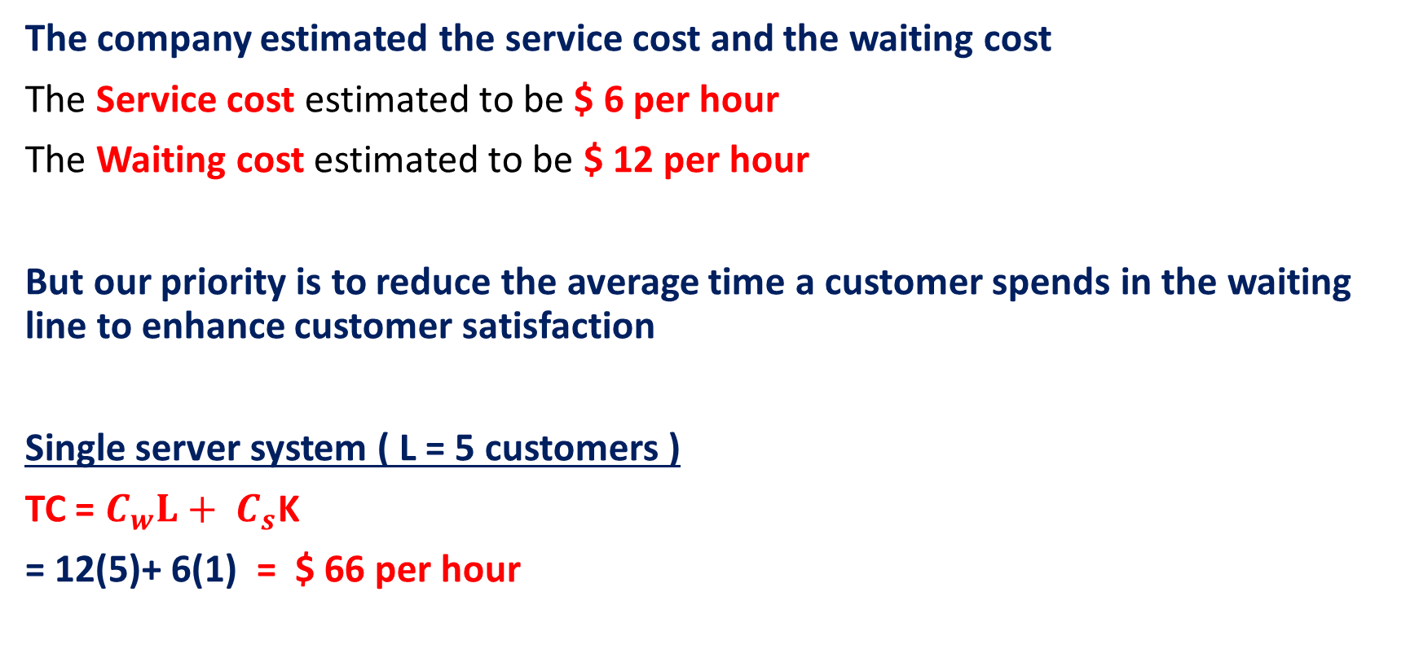
Economic Analysis of Waiting Lines
The company estimated the service cost and the waiting cost
The Service cost estimated to be $ 6 per hour
The Waiting cost estimated to be $ 12 per hour
But our priority is to reduce the average time a customer spends in the waiting line to enhance customer satisfaction
Single server system ( L = 5 customers )
TC = $C_{w}L+ C_{s}$K
= 12(5)+ 6(1) = $ 66 per hour

Slide 23
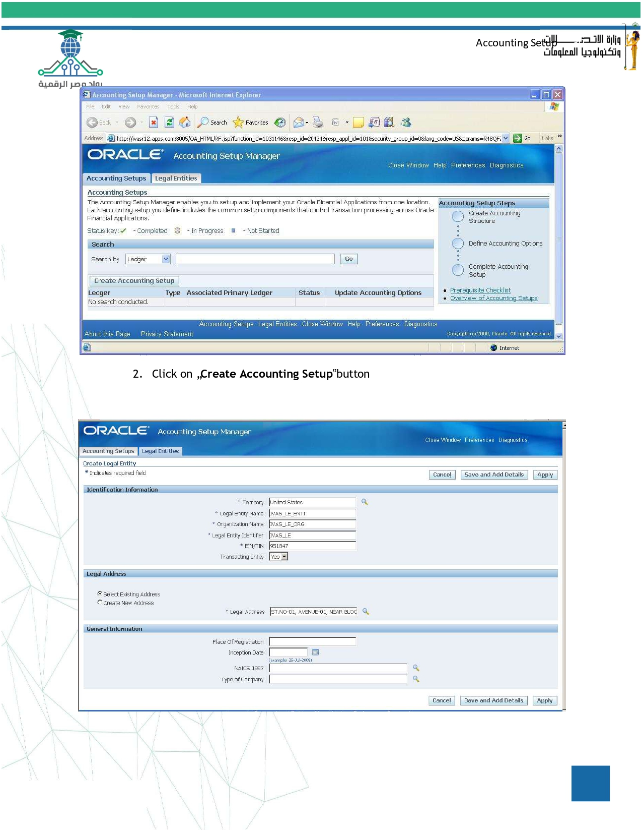
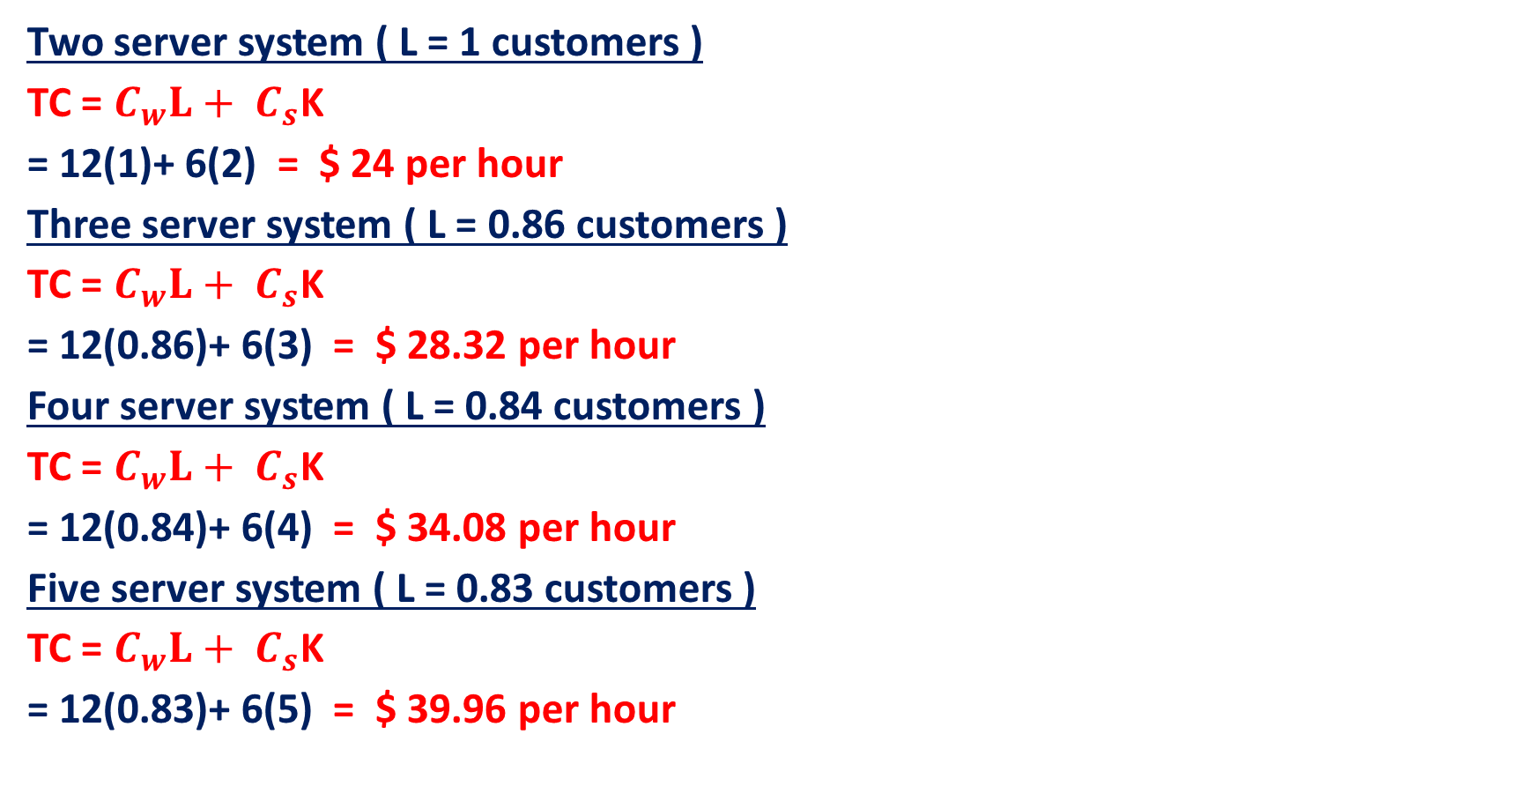
Economic Analysis of Waiting Lines
Two server system ( L = 1 customers )
TC = $C_{w}L+ C_{s}$K
= 12(1)+ 6(2) = $ 24 per hour
Three server system ( L = 0.86 customers )
TC = $C_{w}L+ C_{s}$K
= 12(0.86)+ 6(3) = $ 28.32 per hour
Four server system ( L = 0.84 customers )
TC = $C_{w}L+ C_{s}$K
= 12(0.84)+ 6(4) = $ 34.08 per hour
Five server system ( L = 0.83 customers )
TC = $C_{w}L+ C_{s}$K
= 12(0.83)+ 6(5) = $ 39.96 per hour

Slide 24
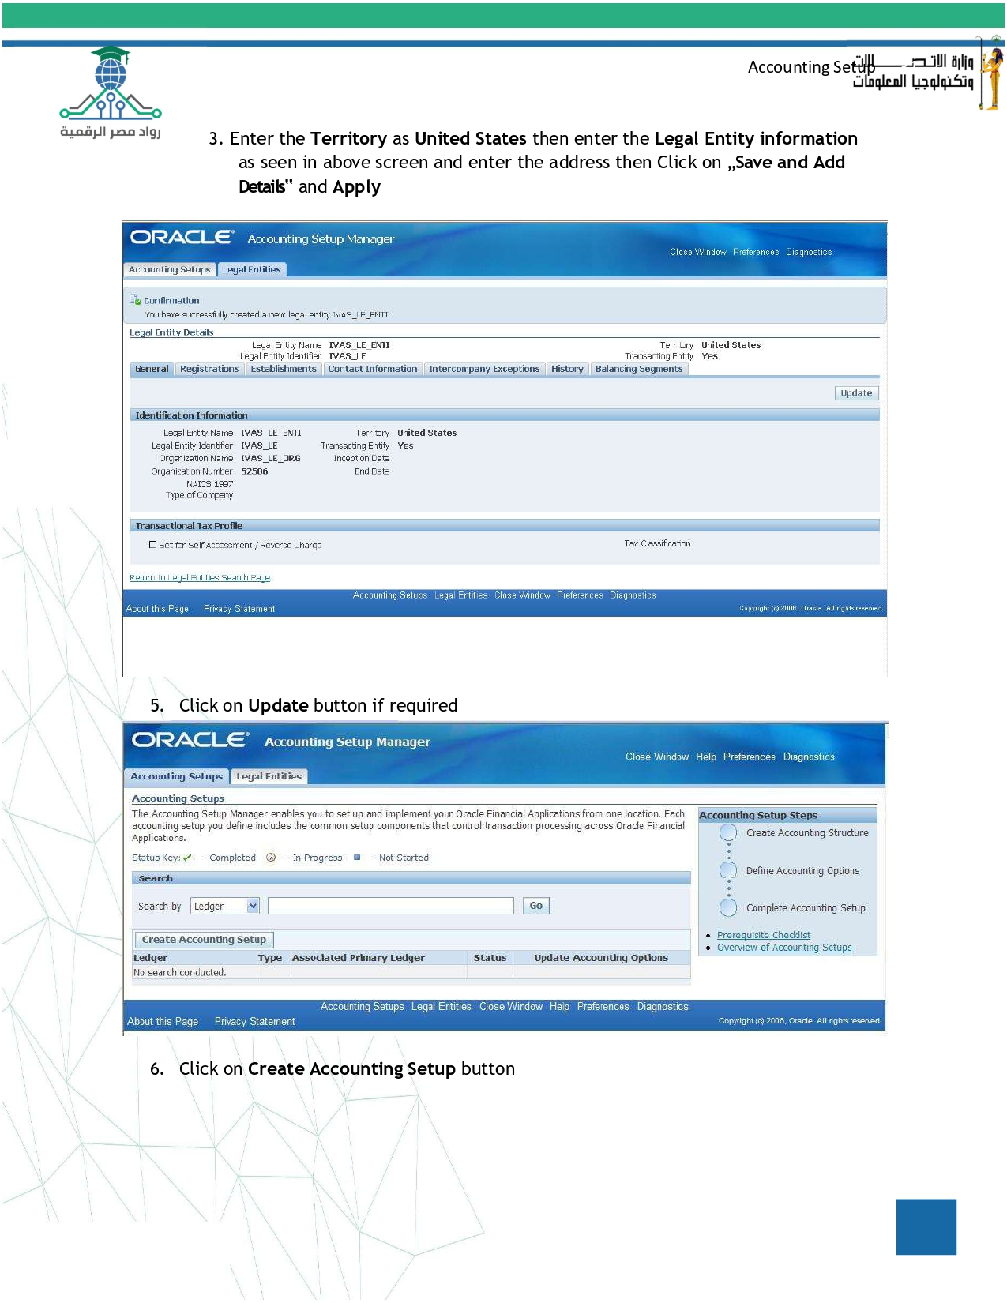
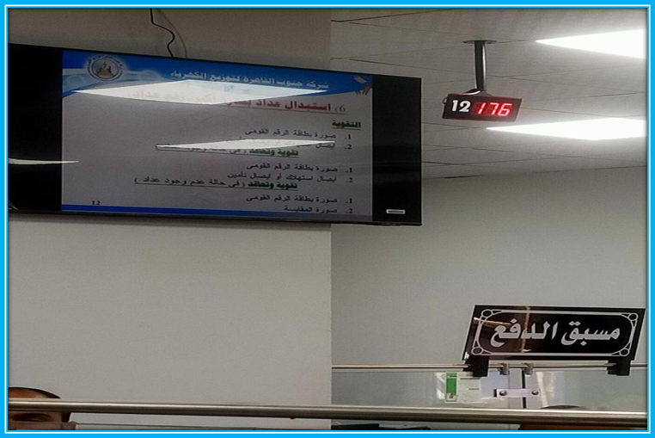
The result
We advice the company to rely on five server system to achieve their main goal “ reduce the average time a customer spends in the waiting line to enhance customer satisfaction.

Slide 25
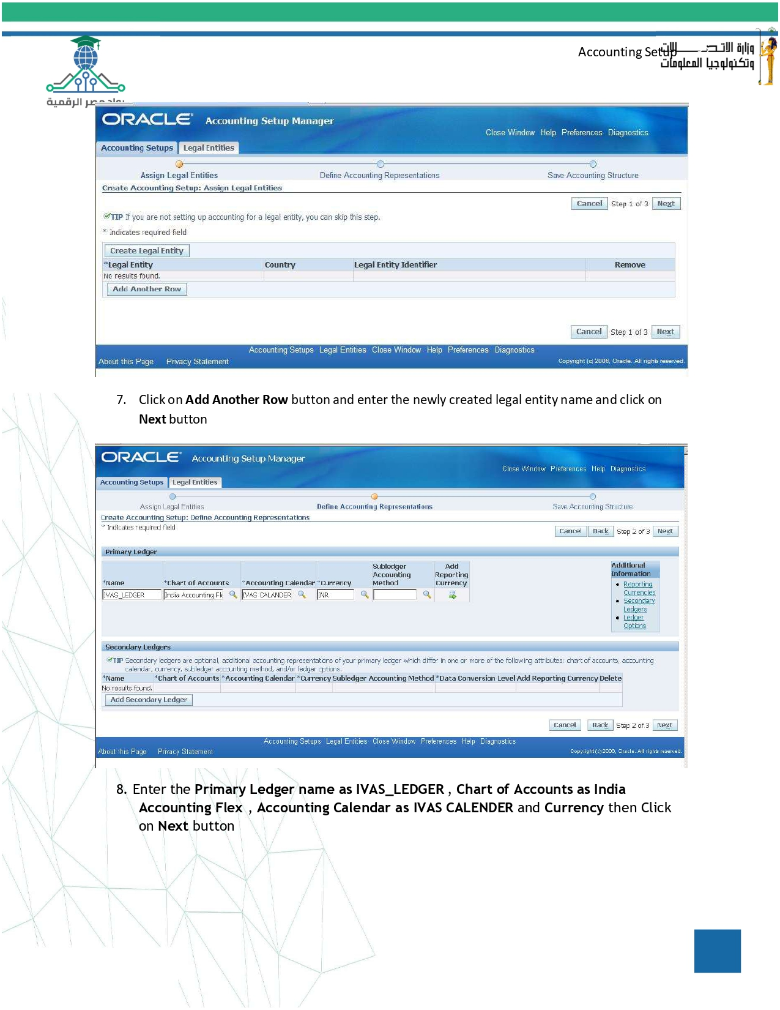
Thanks

Slide 26
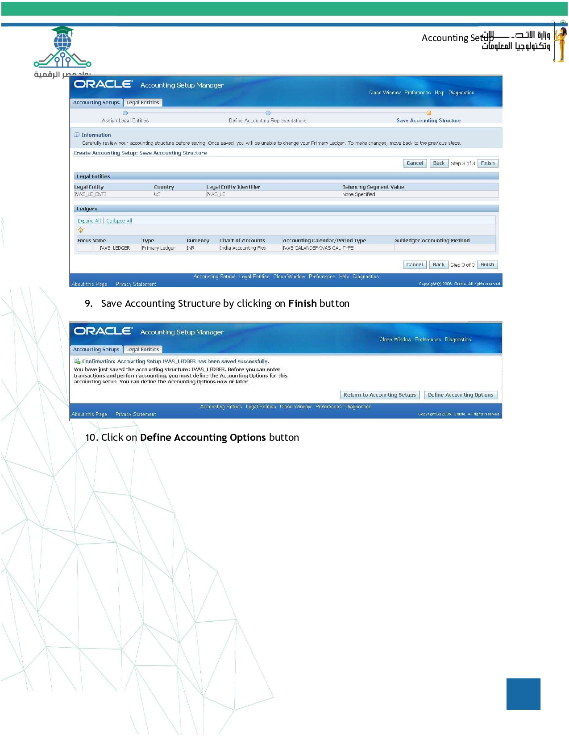

Slide 27
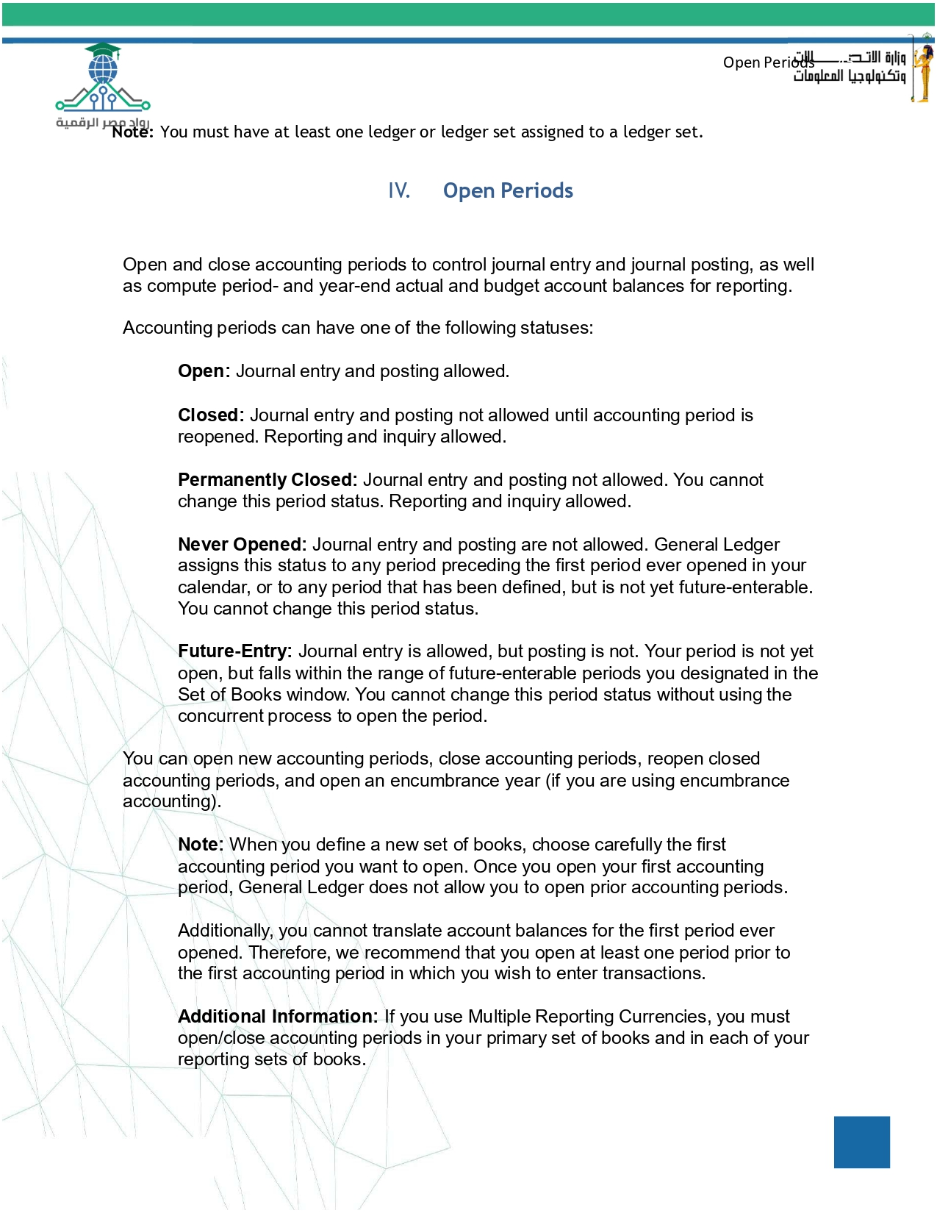

Slide 28
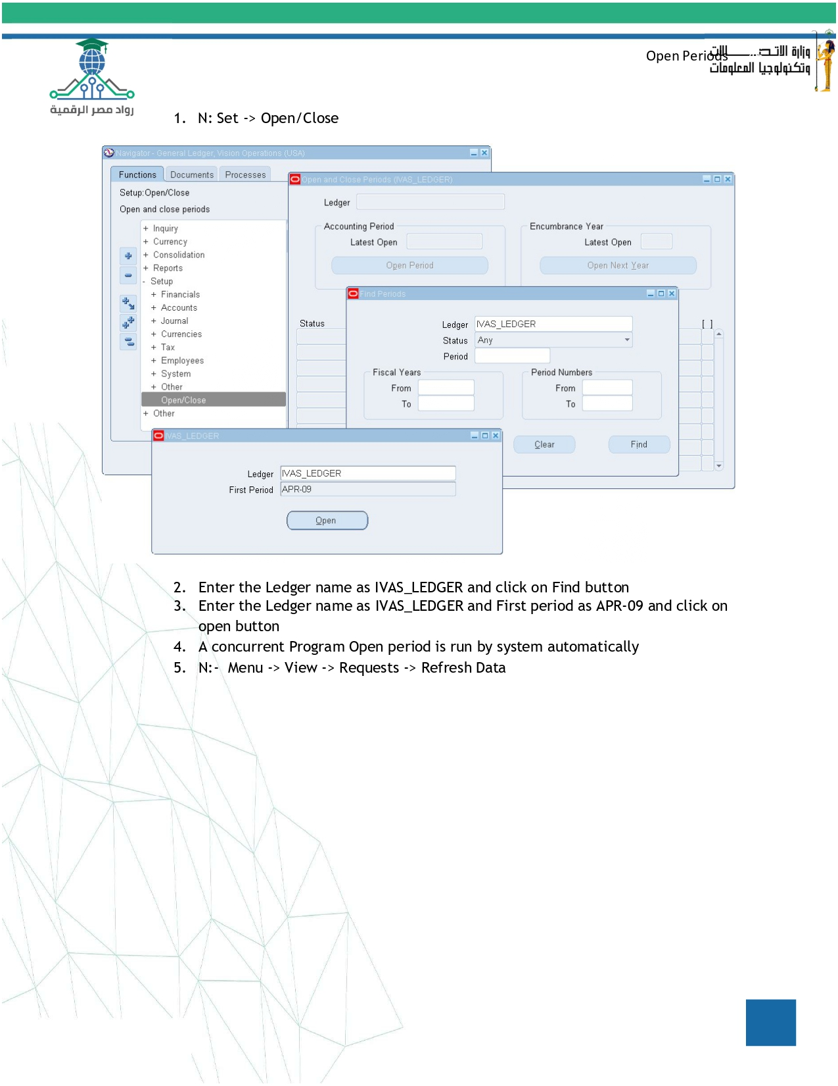

Slide 29
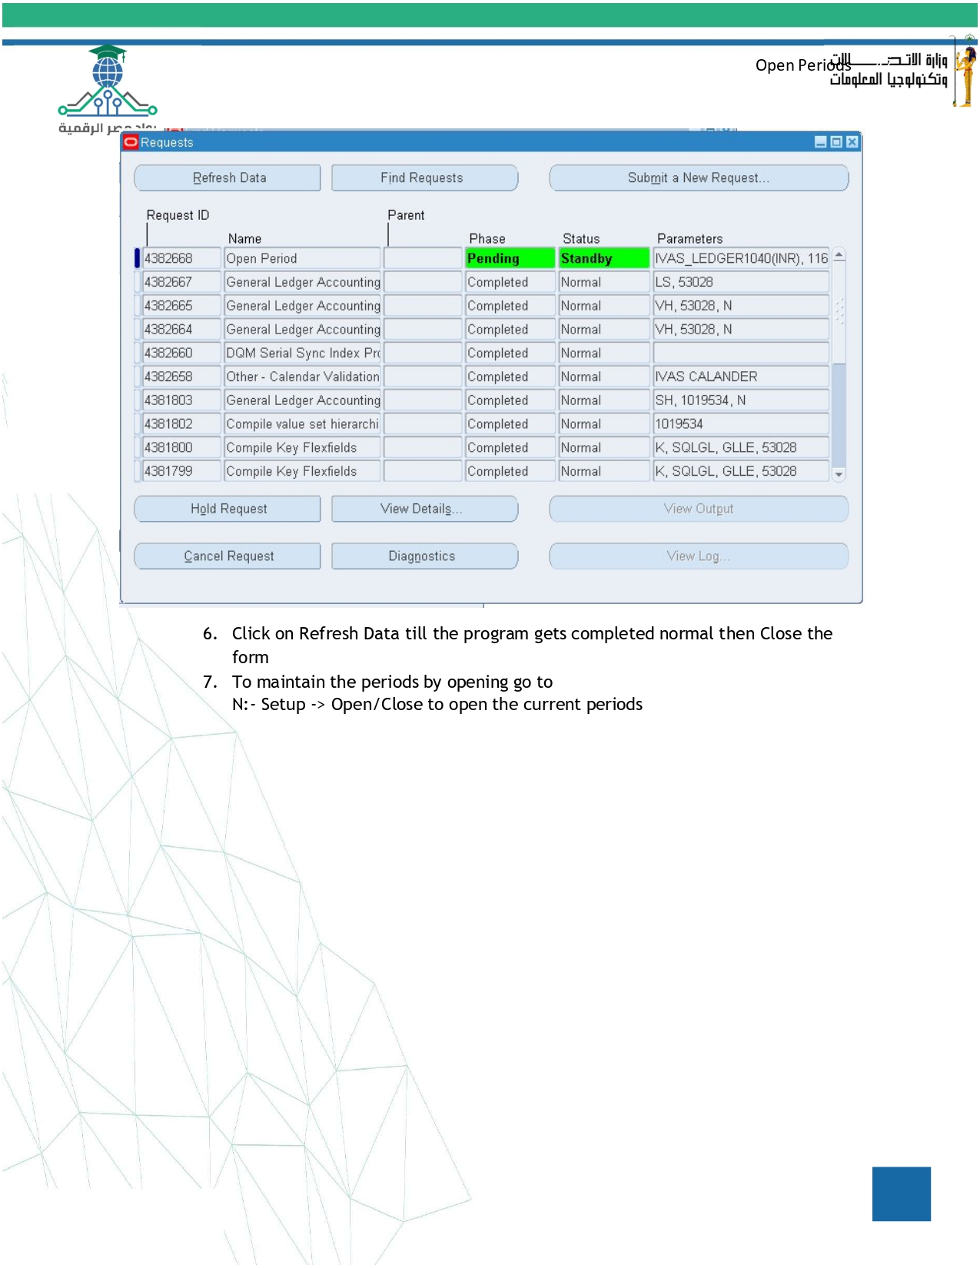

Slide 30
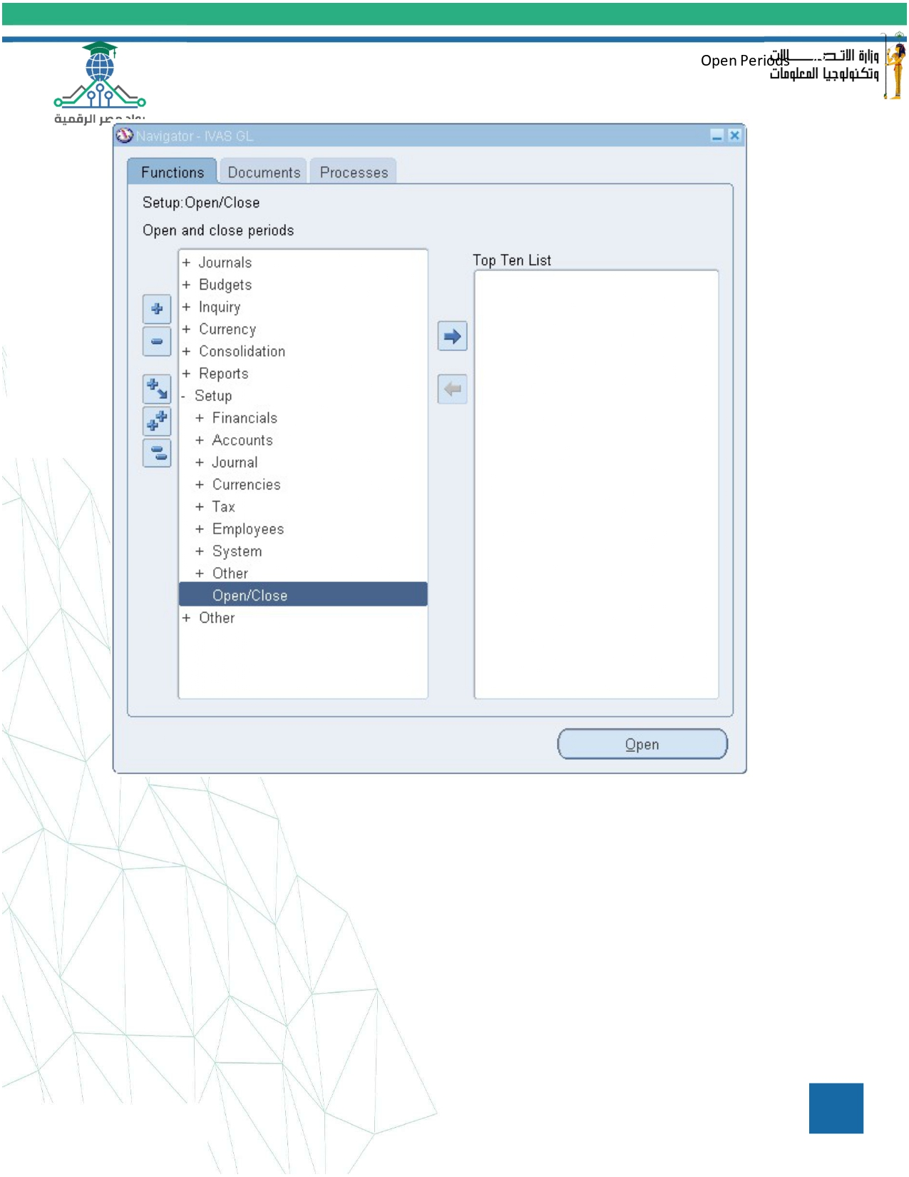

Slide 31
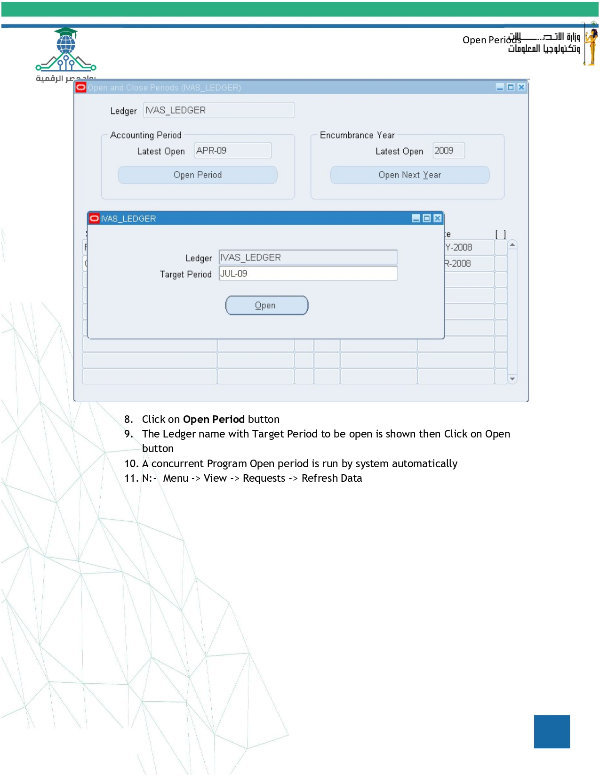

Slide 32
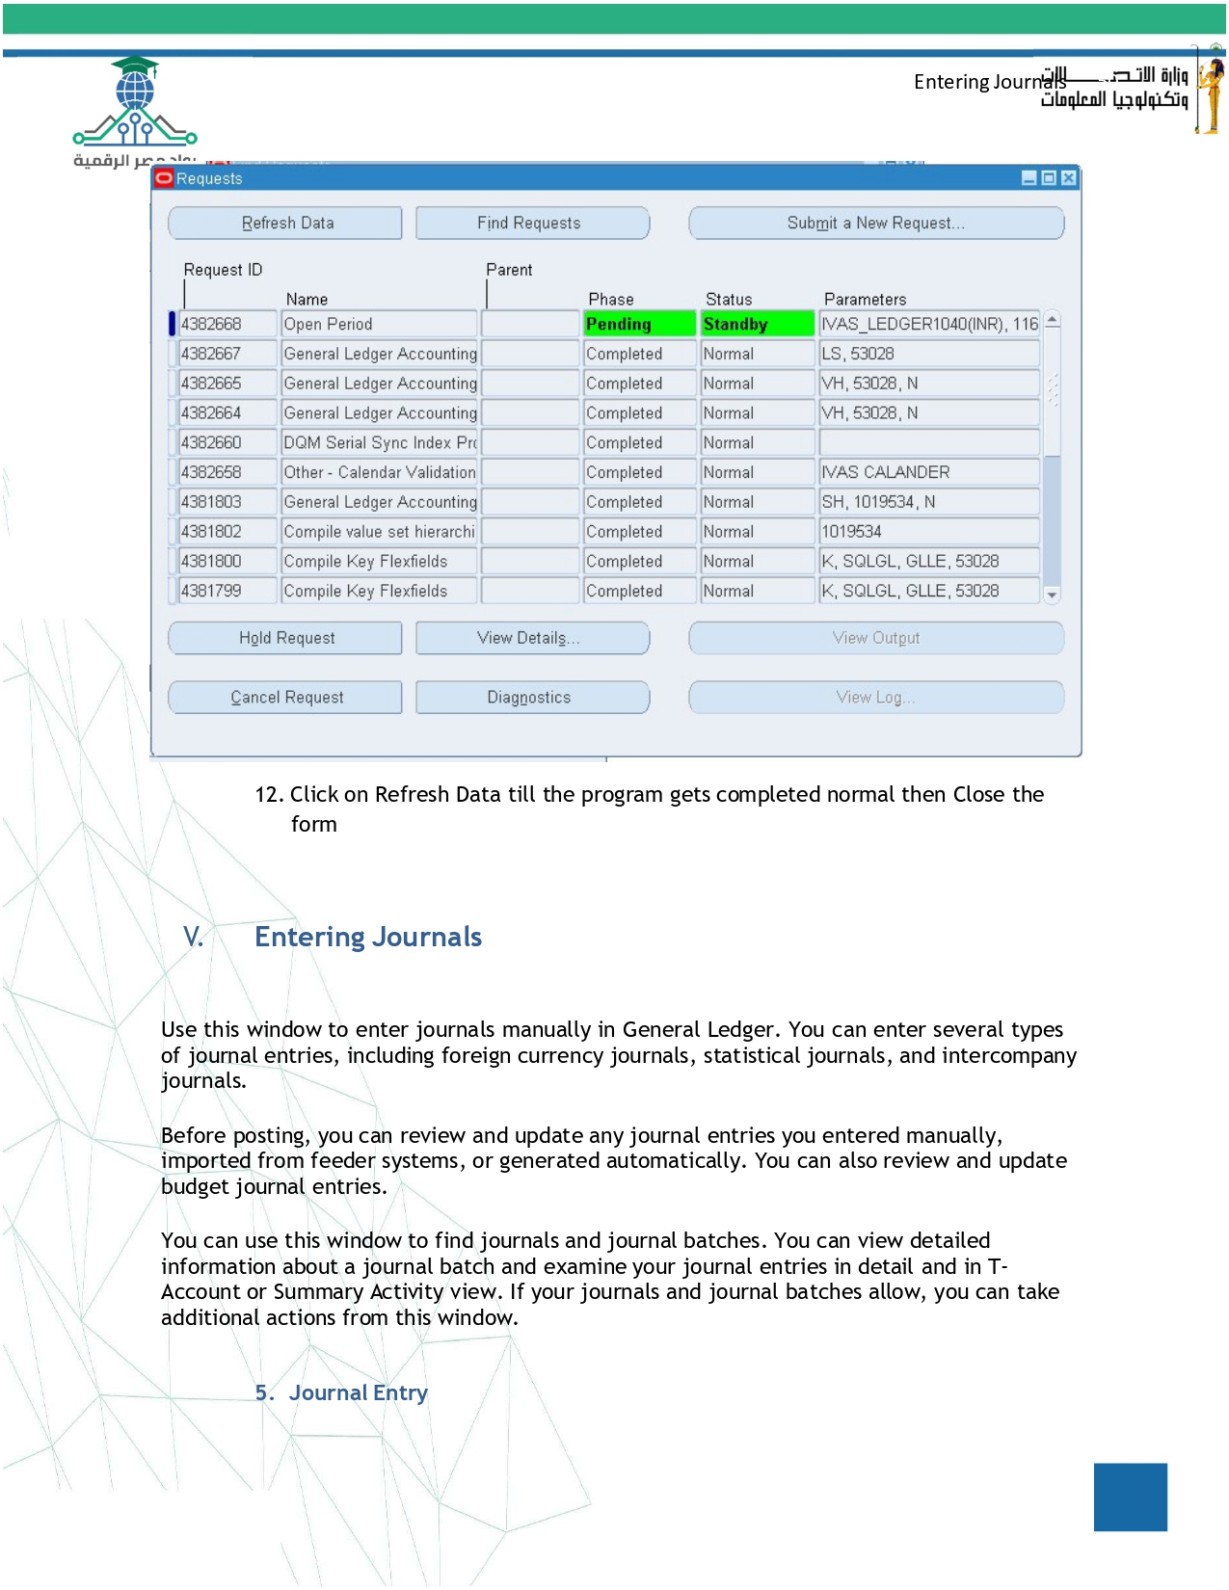

Slide 33
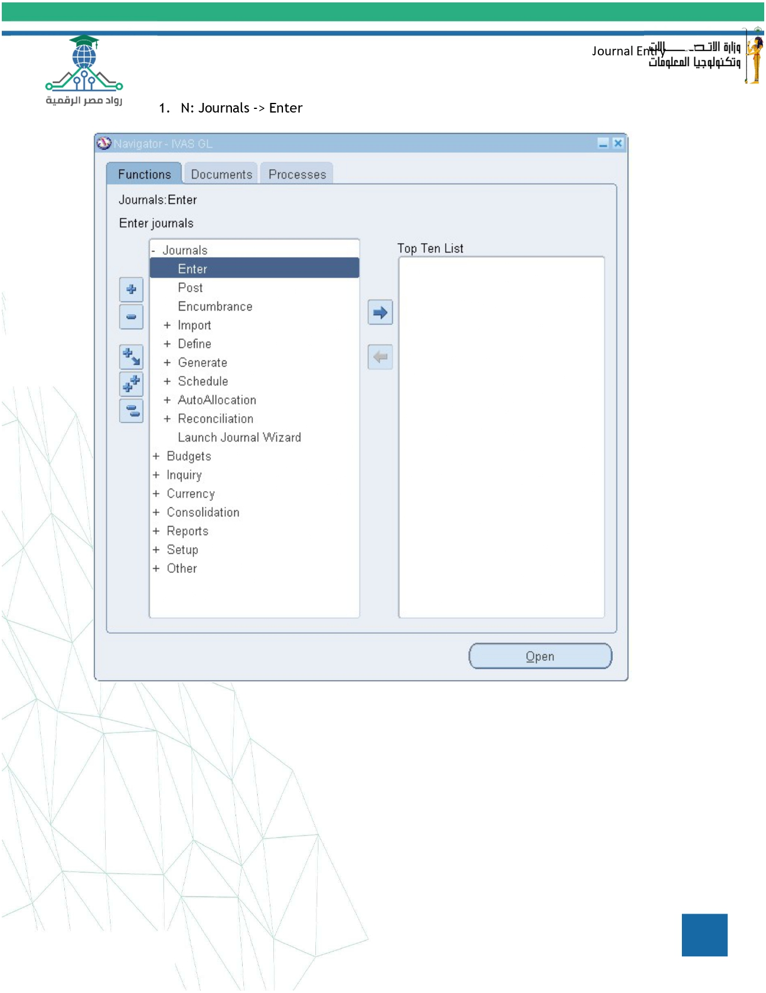

Slide 34
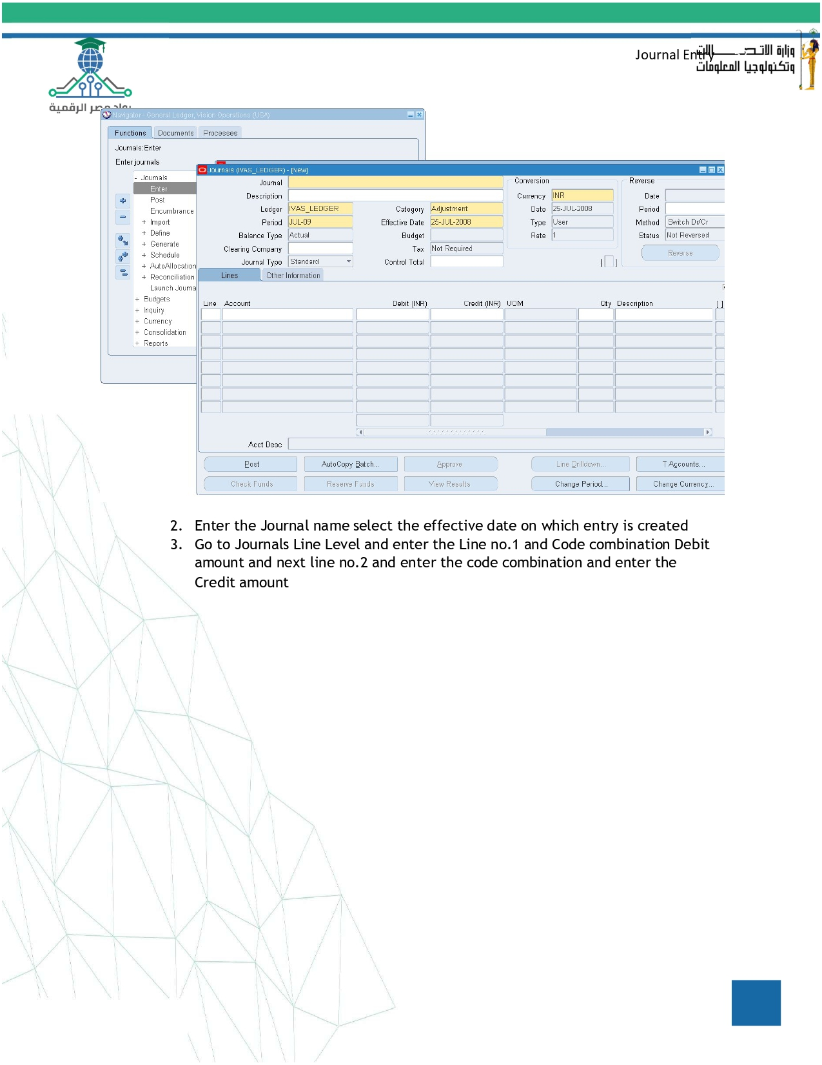

Slide 35
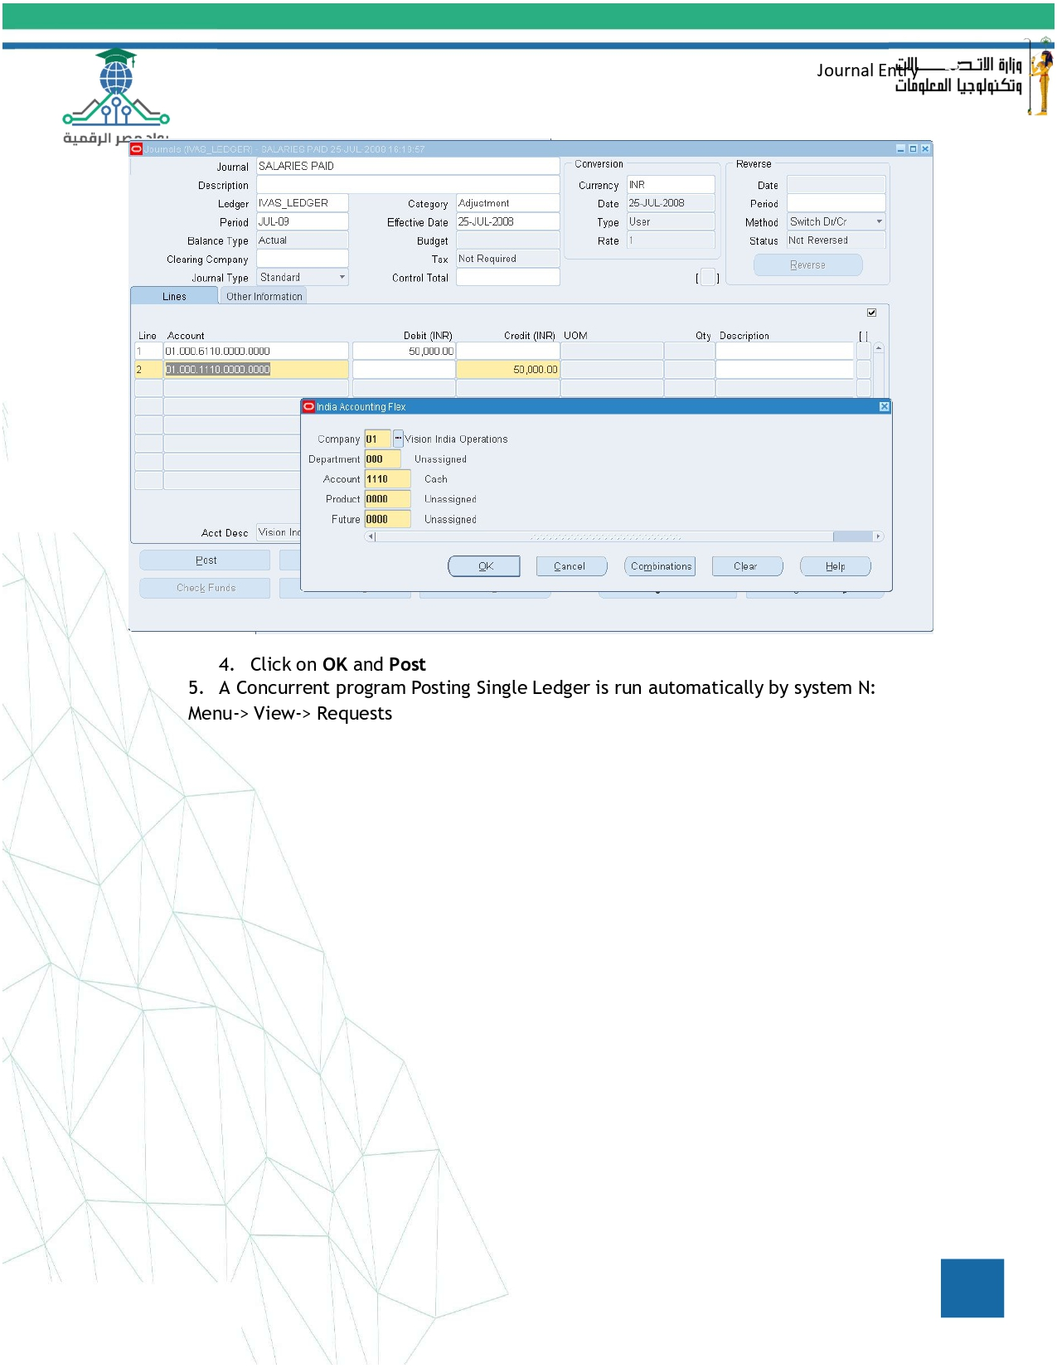

Slide 36
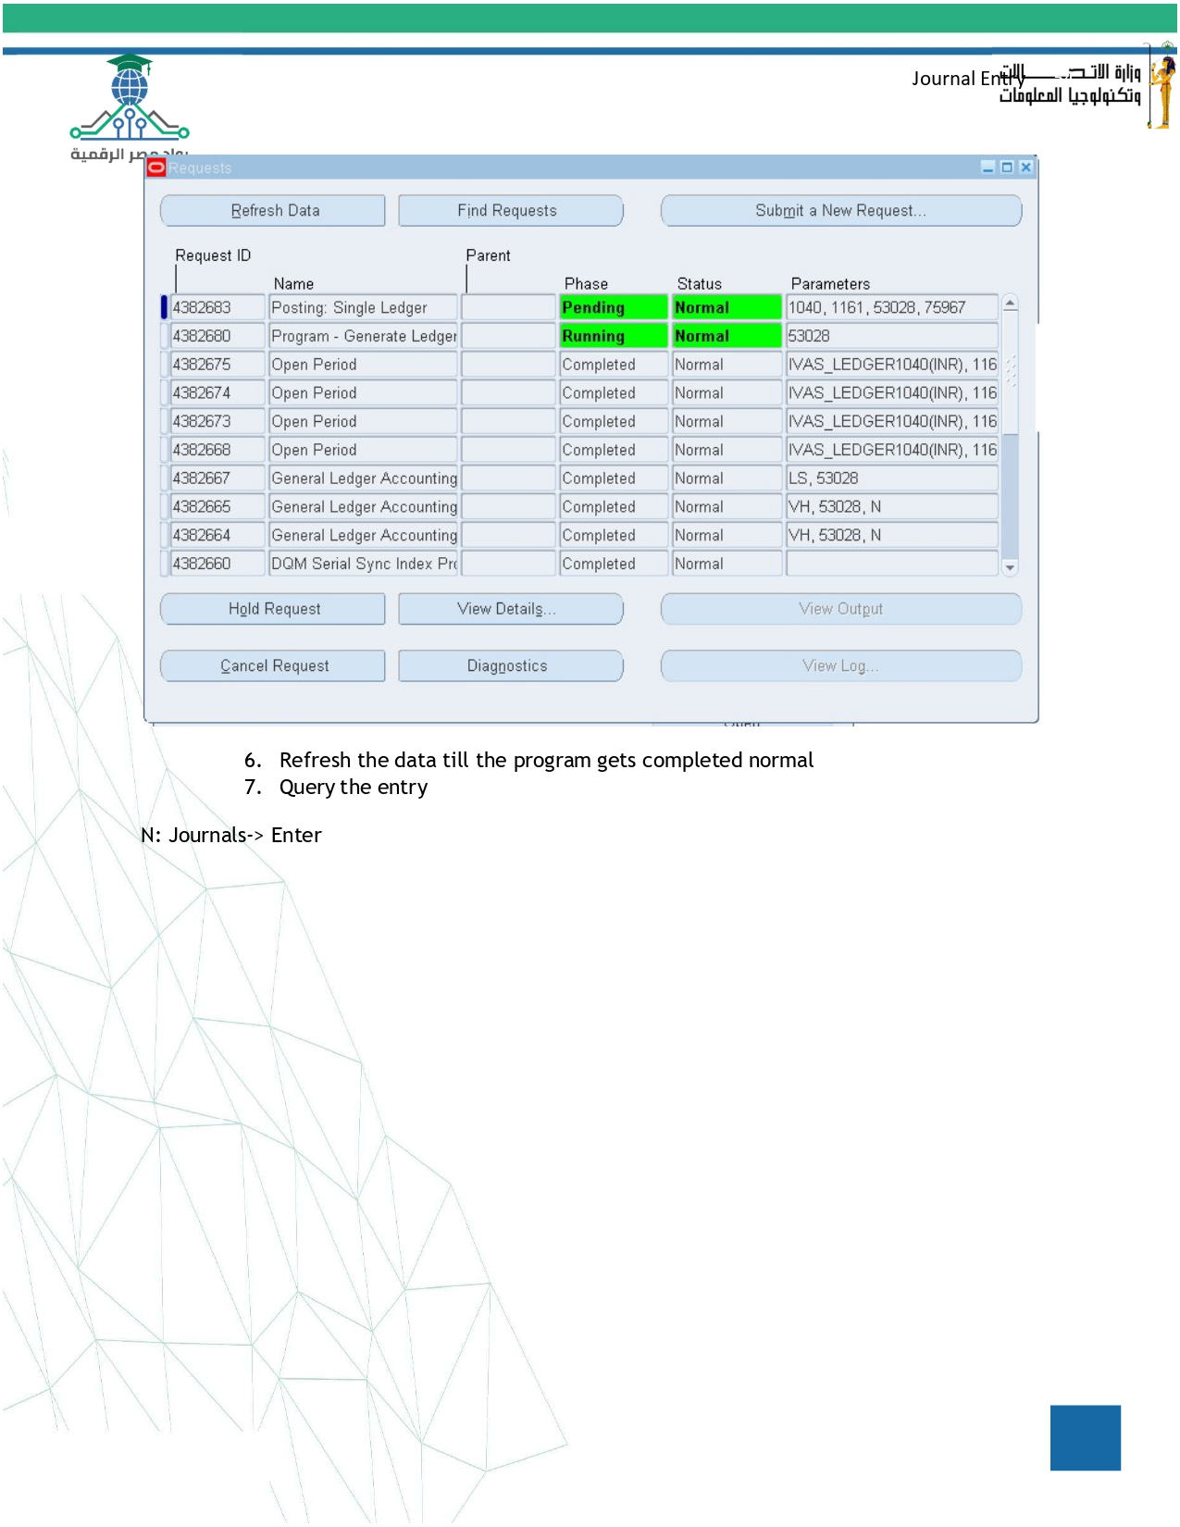

Slide 37
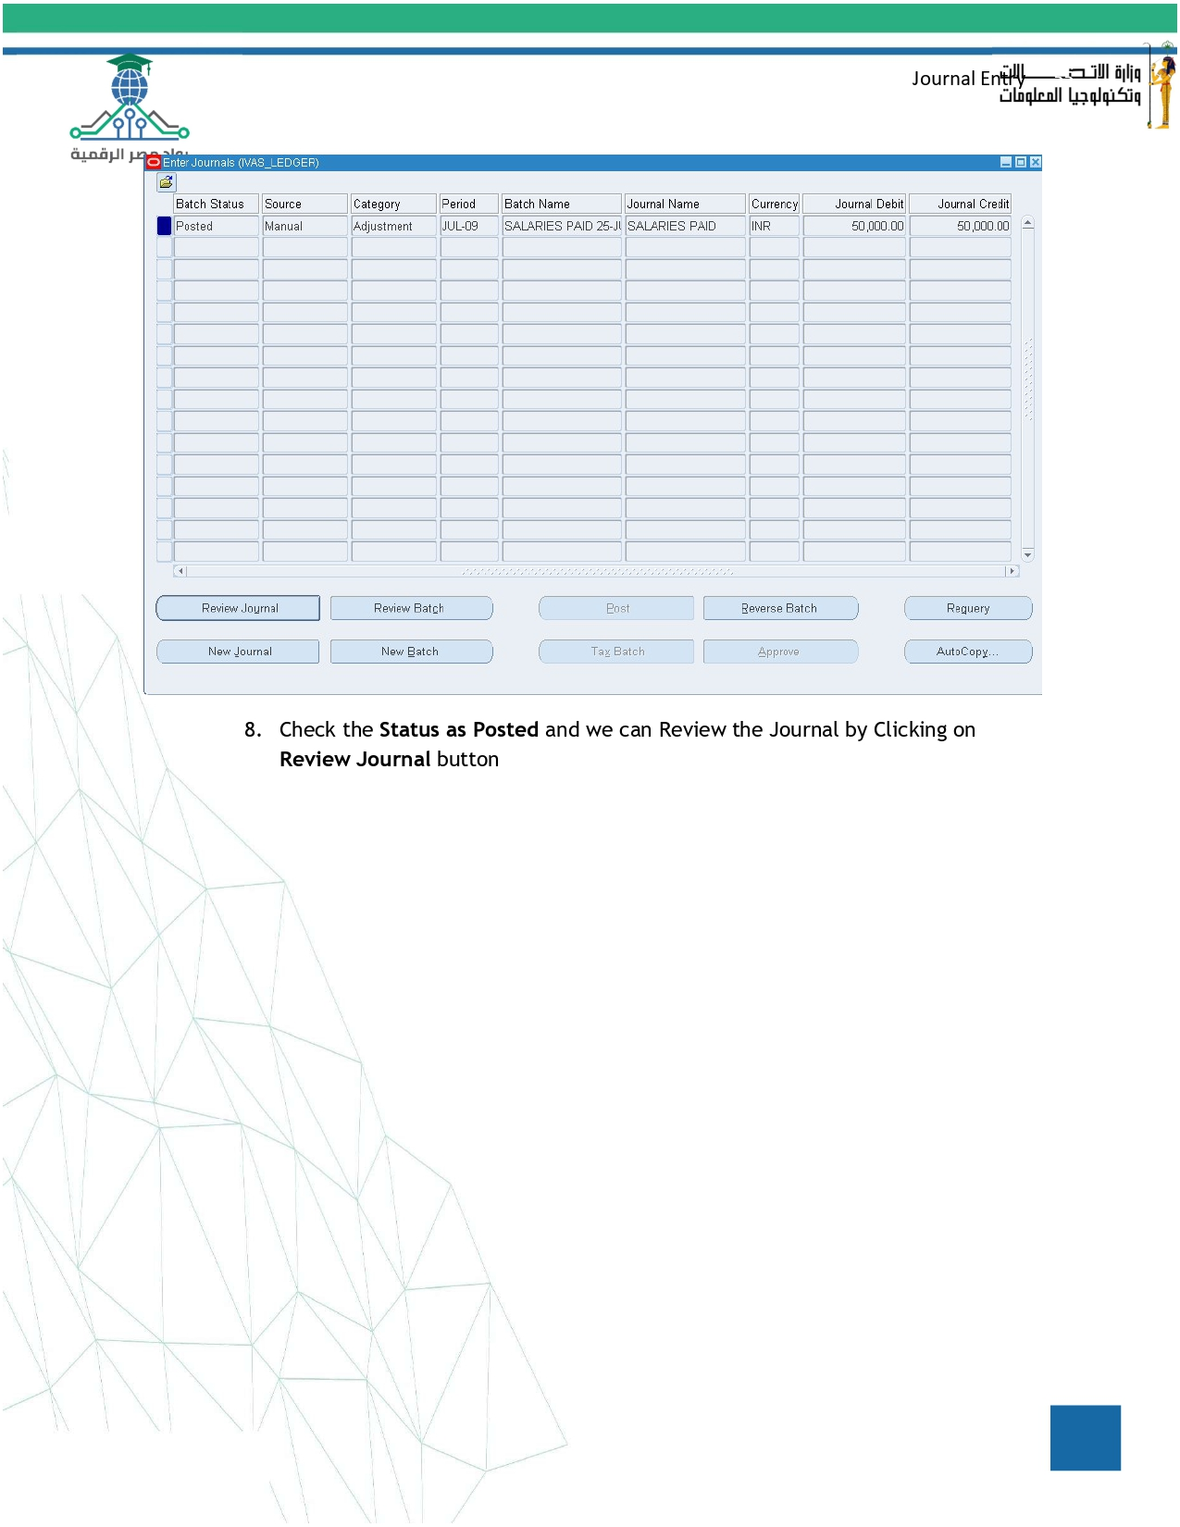

Slide 38
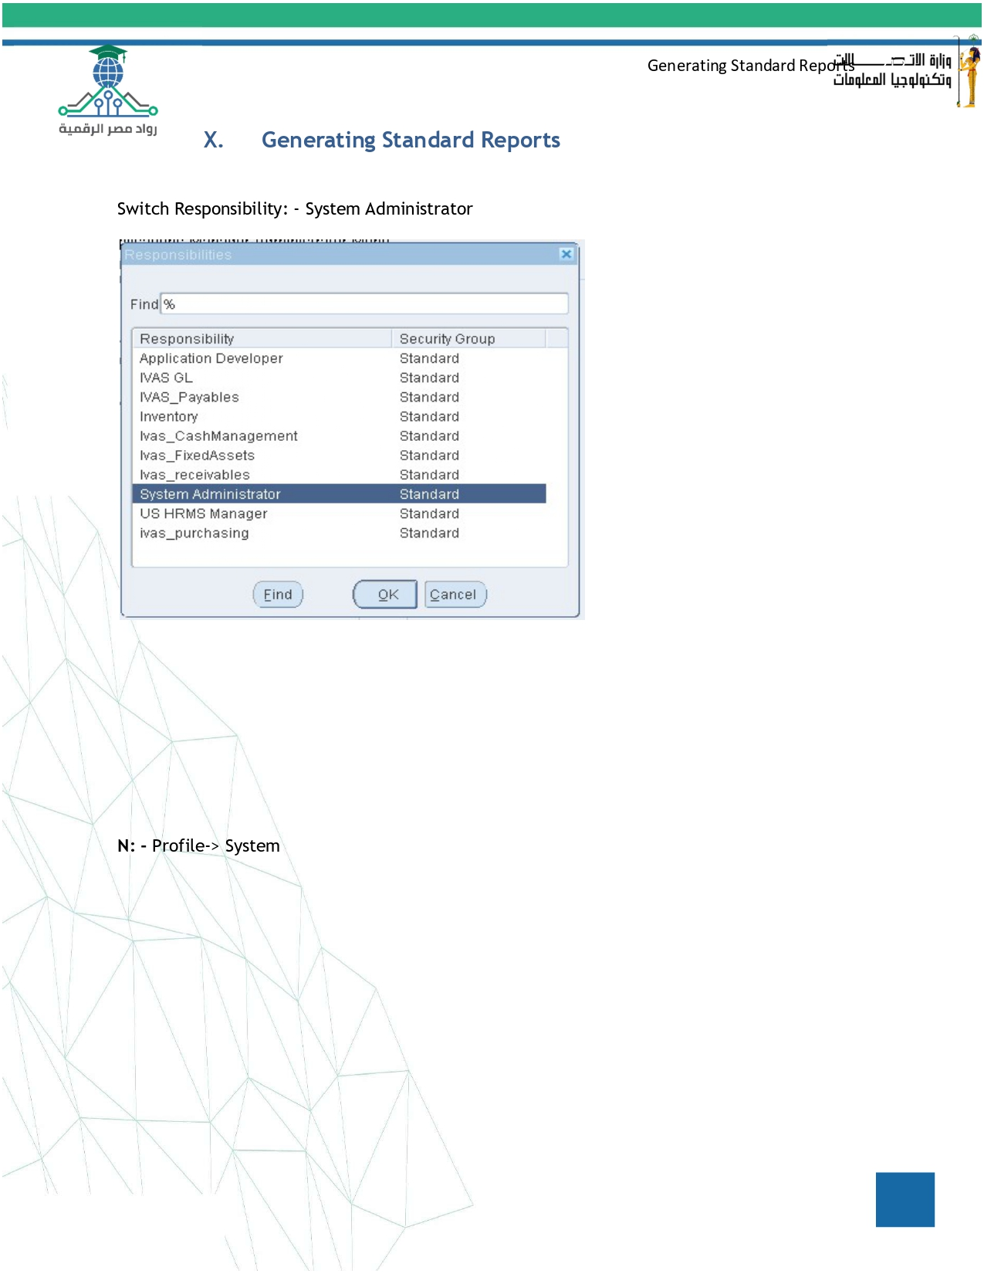

Slide 39
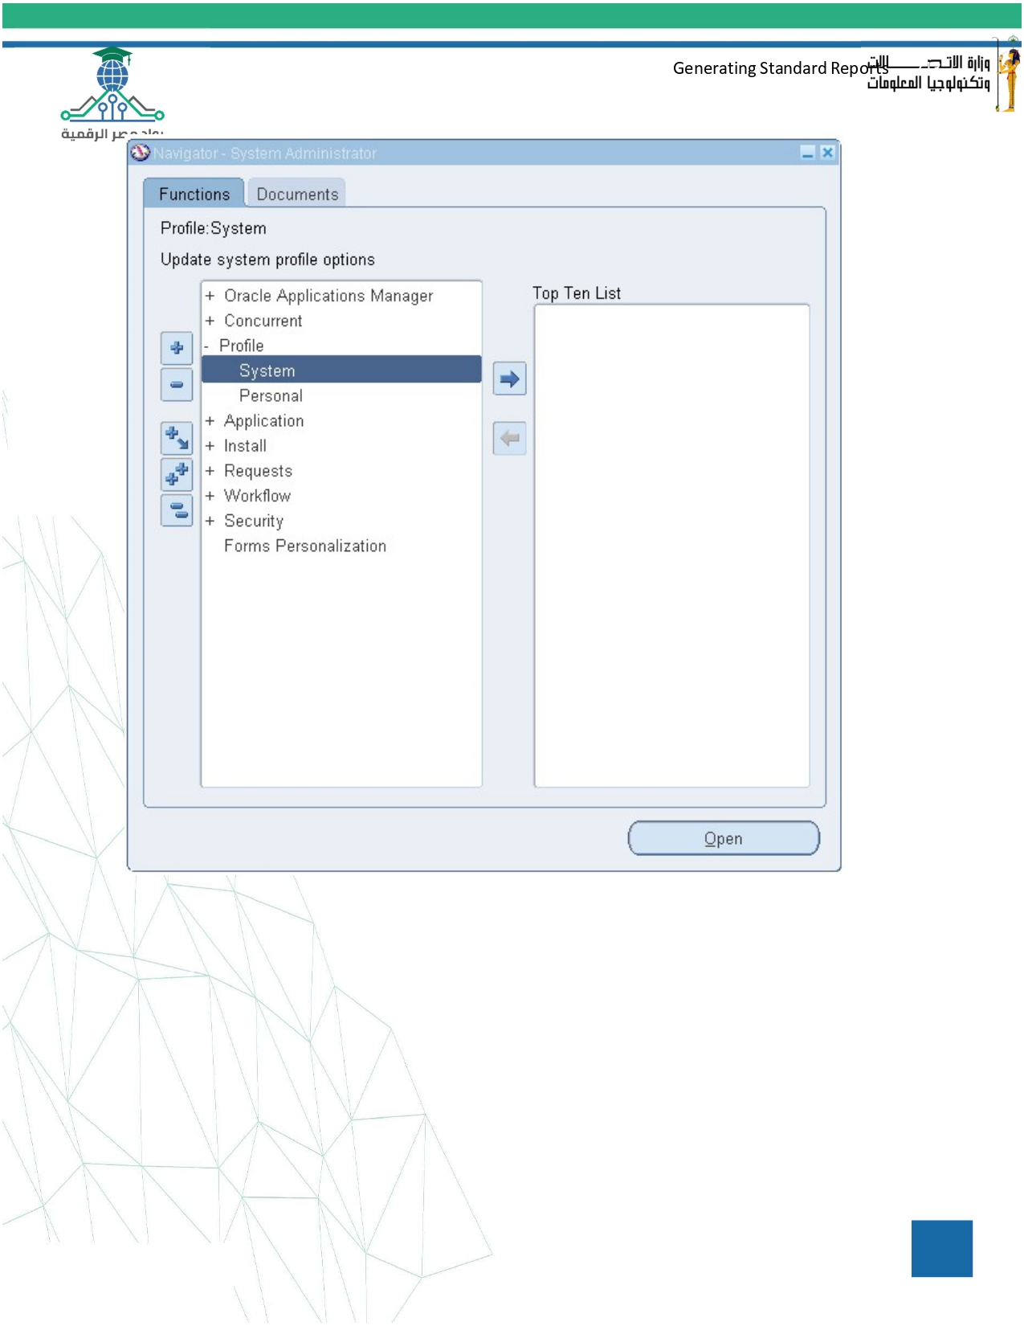

Slide 40
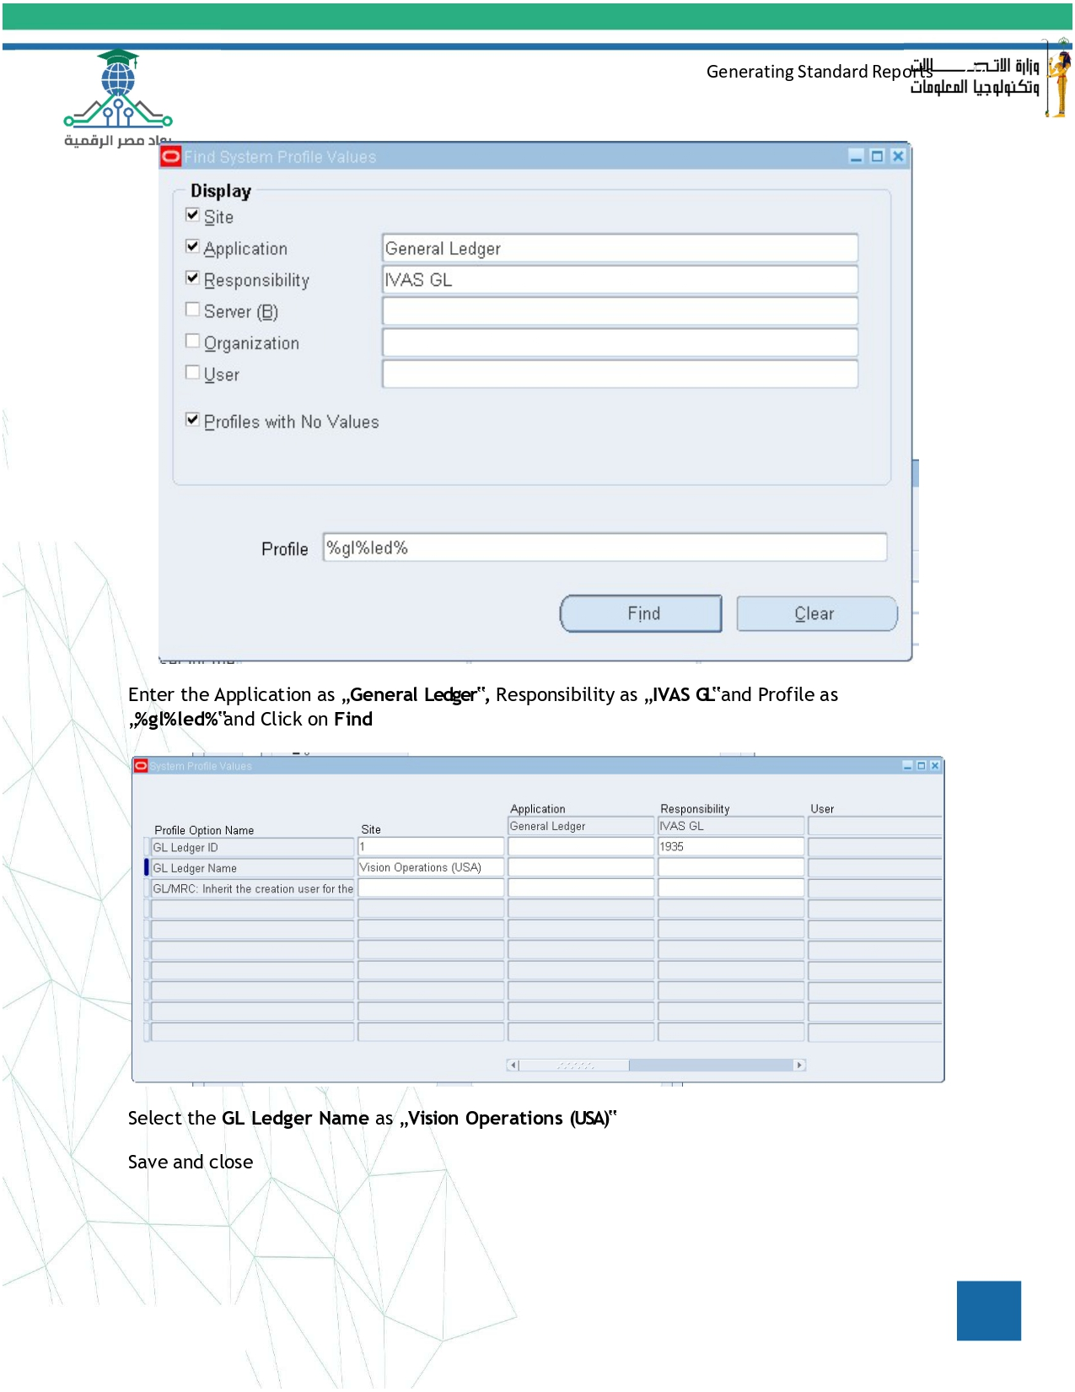

Slide 41
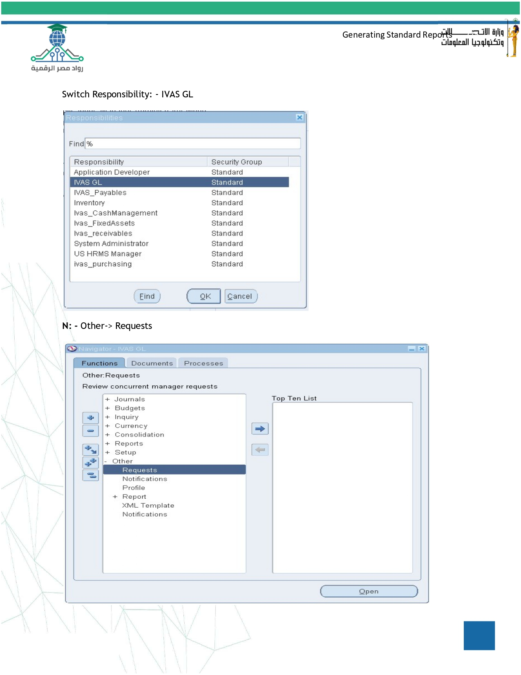

Slide 42
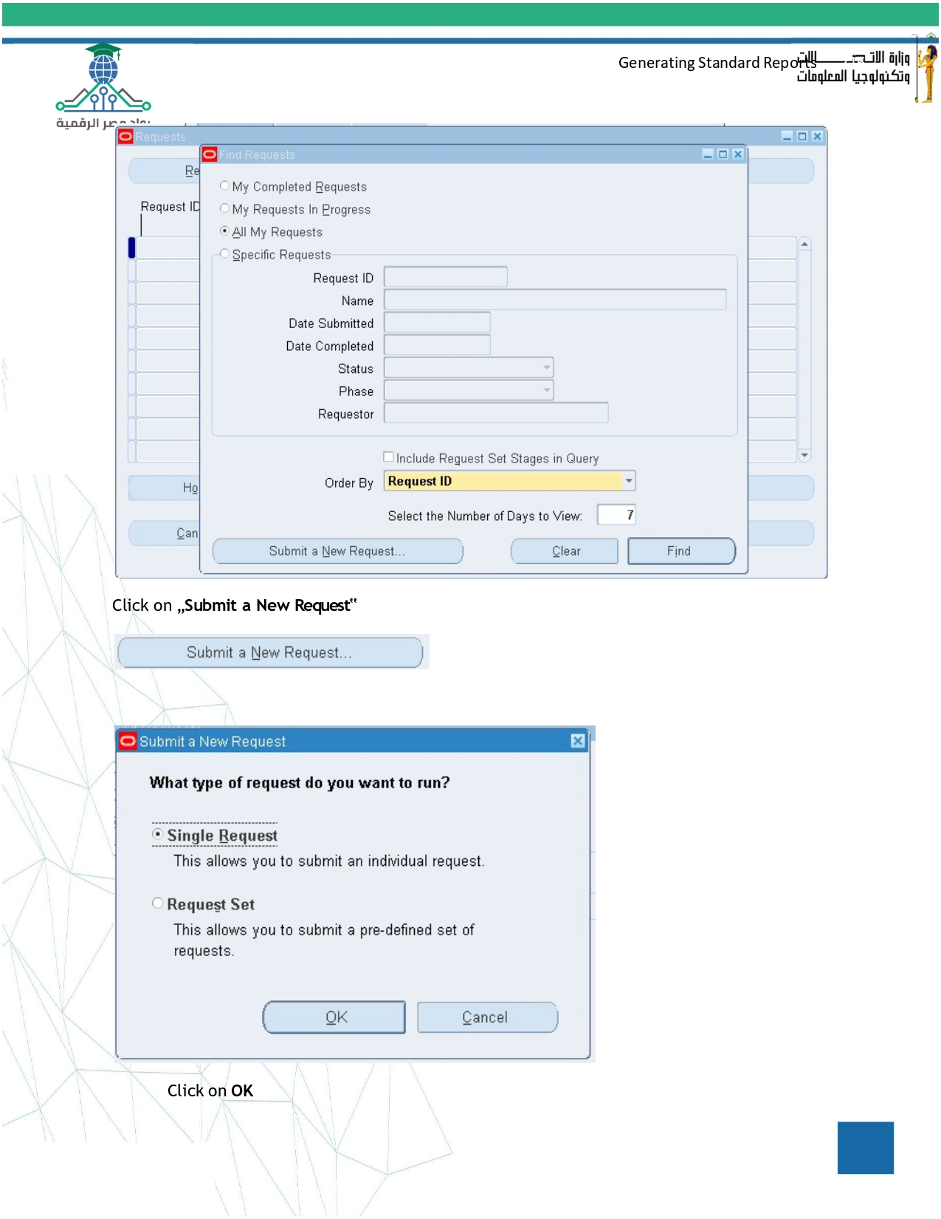

Slide 43
